Slide 1
Reviewing the Absence Notification
Columbus City Schools

Slide 2
Notification of Absence Reason
The superintendent shall require from the parent of each student who has been absent from school or from class for any reason, a statement of the cause for such absence.
The Board of Education reserves the right to verify such statements and to investigate the cause of each single absence or prolonged absence.
[Board Policy 5131.3]

Slide 3
Reviewing Absence Notes and Phone Calls
Each attendance note should be reviewed prior to entering it into Infinite Campus.

Slide 4
First things first….
All attendance notes are to be reviewed. When a note meets specific criteria it can be changed to excused in Infinite Campus. When reviewing the note keep the following questions in mind:
Who wrote the note?
The note should be written by a parent, guardian, or medical professional
When was the note received?
The note must be received within one week of the last day of absence
Does the reason given excuse the absence according to the Board Policy?
If you have questions or concerns about modifying any absence please refer to current Board Policy and Attendance and Accountability Guidelines.

Slide 5
Acceptable Reasons for Excused Student Absences
Review the reason
Medical or Dental appointment
Personal Illness
Illness or death in the immediate household
Emergency
Observation of a Religious Holiday
College Visitation
Preparation for Graduation Ceremony
(Grade 12 Only, Maximum 3 days)
Superintendent’s Designation
Any other reason specified pursuant to Ohio Law
If the reason given does not
align with these approved guidelines, the absence should remain unexcused

Slide 6
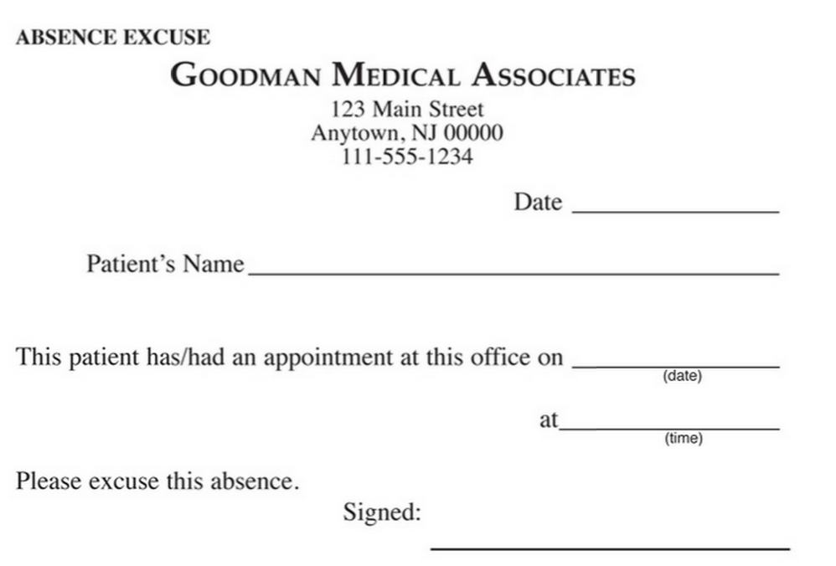
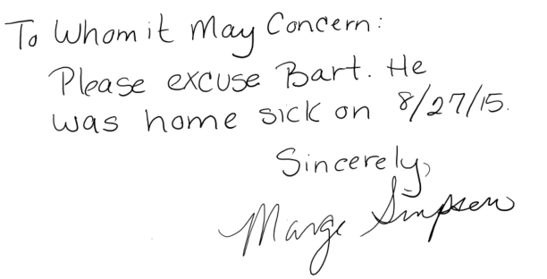
The Most Common Types of Notes
Phone Call or Verbal Statement
Written Note from Parent/Guardian
Written Note from
Medical Professional

Slide 7
Written Attendance Notes
Written Note from
A Parent/Guardian
All Written Attendance Notes must contain key items:
Date written
Student’s Name
Date(s) of absence
Reason
Parent Signature

Slide 8
Written Attendance Notes
All Attendance Notes from medical professionals must contain key items:
Date written
Student’s Name
Date(s) of absence
Signature
Written Note from
A Medical Professional

Slide 9
Phone Calls
It is the expectation of the District that telephone calls from a student’s parent or guardian, or from an adult student notifying the school of a student absence will be made prior to 9:30.
The following information should be collected during the phone call:
Date and Time of the call
Student Name
Absence Dates
Name of Caller
Reason for Absence
Name of Person recording the notification

Slide 10
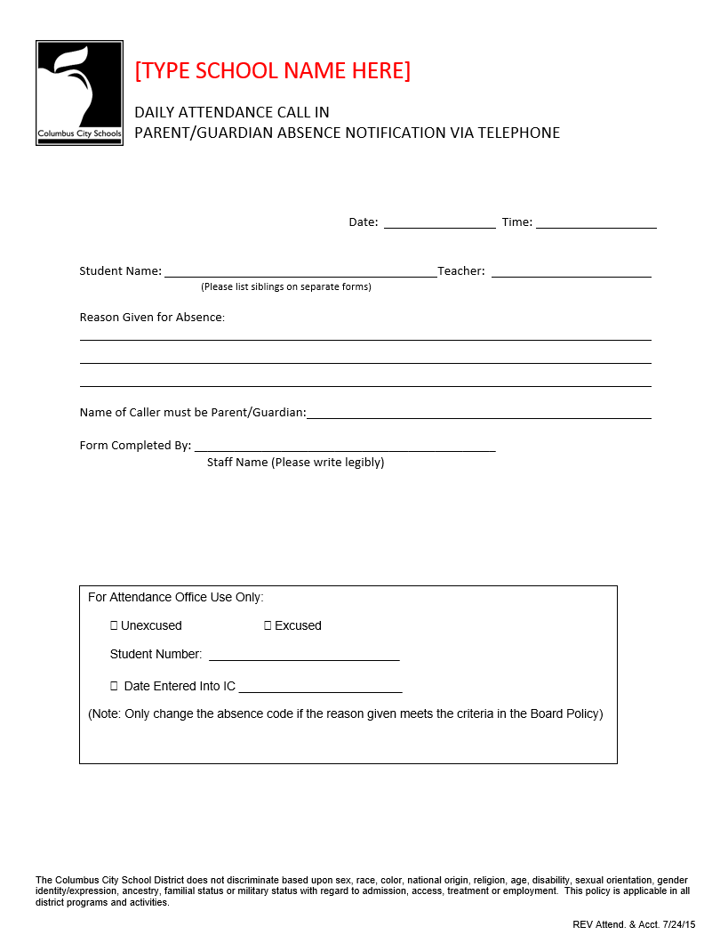
How to Document Attendance Phone Calls
By Individual Student

Slide 11
Attendance Accountability
The school shall maintain documentation of every phone call used to modify an Attendance Event.
The “Parent/Guardian Absence Notification via Telephone” form should be retained with the student attendance file for that school year.

Slide 12
Obtaining Additional Approval
Prior to entering the note into Infinite Campus you will need to determine if additional Principal approval is required.
You should obtain approval before making any changes in the following situations:
The note was received more than one week from the date of absence
or
The parent already submitted more than 9 excuse dates
The “Request For Excused Absence” is a standardized form used to obtain this approval.

Slide 13
Documenting the modification
When requesting approval, the secretary will print the Period Detail report from Infinite Campus prior to making any changes to the electronic record
For audit purposes the following documentation must be retained in the student attendance record:
Attendance Note
“Request For Excused Absence” Form
Period Detail Report

Slide 14
Entering the Absence Notification
After review and approval, each note should be entered into Infinite Campus. For specific instructions on this process refer to the
Changing an Unexcused Absence to Excused Video

Slide 15
Attendance Accountability
Every time an attendance event is modified the change is tracked electronically in Infinite Campus.
The attendance office must maintain physical files for every student containing all attendance related notes.
Each student will have a manila attendance file folder prepared.
The files are to be sorted alphabetically by Last Name then First Name.
Attendance notes must NOT be stored in the student’s cumulative record.
All attendance notes must be stored in an accessible filing cabinet dedicated to attendance documentation
Additionally, the following documents must be retained with the attendance files for each school year:
Parent/Guardian Absence Notification via Telephone
Late Arrival Logs and Early Release Logs

Slide 16
Pre-Printed Absence Excuse Note
A pre-printed Attendance Excuse Note is available. This form is intended to remind parents that they need to notify the school as to the reason for an absence.
The attendance office can encourage parents to complete this form if no handwritten note has been received.
The secretary can keep a supply in the school office for parents to complete or teachers can send them home when a student returns to class without a written note.

Slide 17
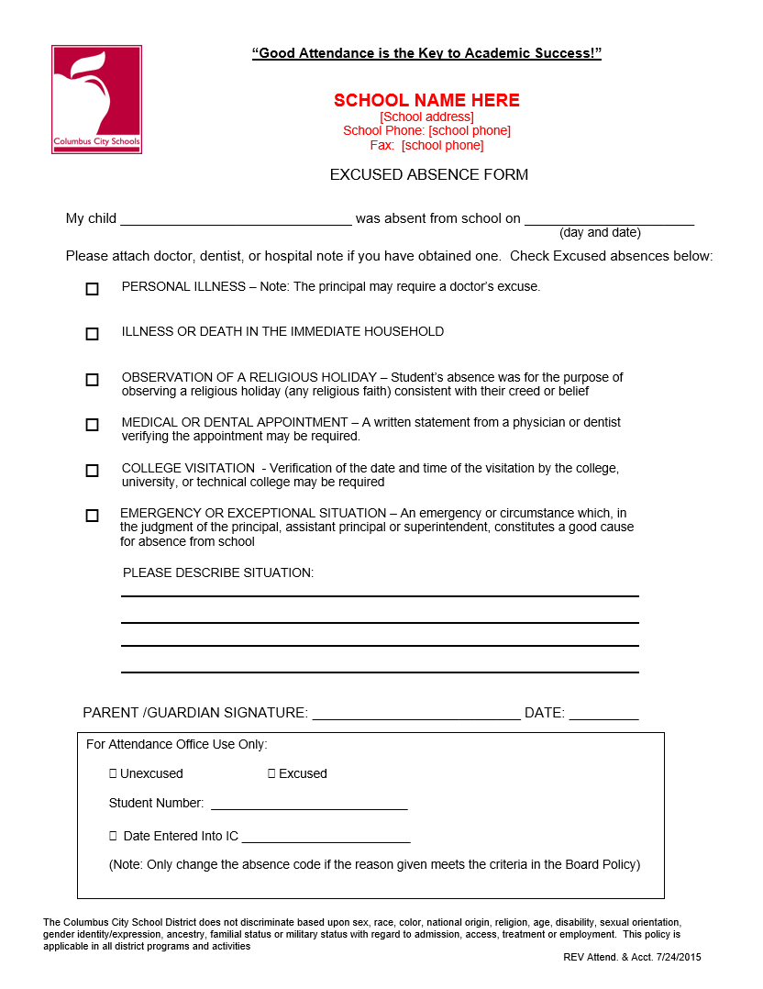
Sample Absence Excuse Note

Slide 18
Overview
All attendance notes must be received reviewed and processed within specific time frames.
Any statement excusing a student’s absence should be submitted to the school attendance office within two days of the student return.
No statement shall be accepted excusing a student’s absence if it is not received within one week of the student’s return to school unless approved, in writing, by the principal.
A maximum of nine (9) student absences from school will be considered excused with parent notification.
After nine(9) absences, additional information and/or documentation in addition to the parent notification may be required in order for the absence to be excused.

Slide 19
Reviewing the Absence Notification
Columbus City Schools

