Slide 1
GRADEBOOK SET UP
Create Categories
Setup Grade Calc Options
Add Assignments
Post Grades
Notes:
Go to www.ccsoh.us and select Staff then the Infinite Campus link. Use the same username and password as your email. Every time you change your login it will change for Infinite Campus as well.

Slide 2
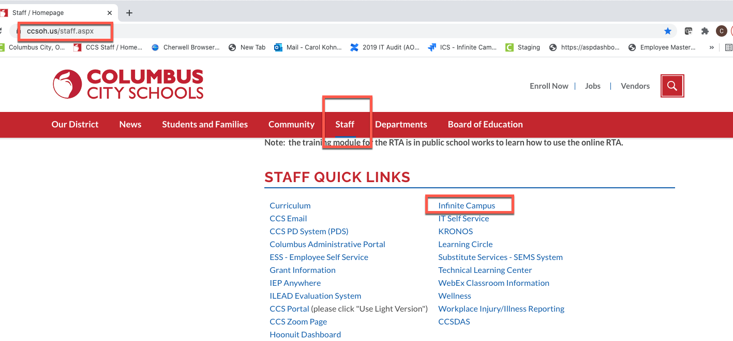
Log into Infinite Campus
Notes:
Go to www.ccsoh.us and select Staff then the Infinite Campus link.

Slide 3
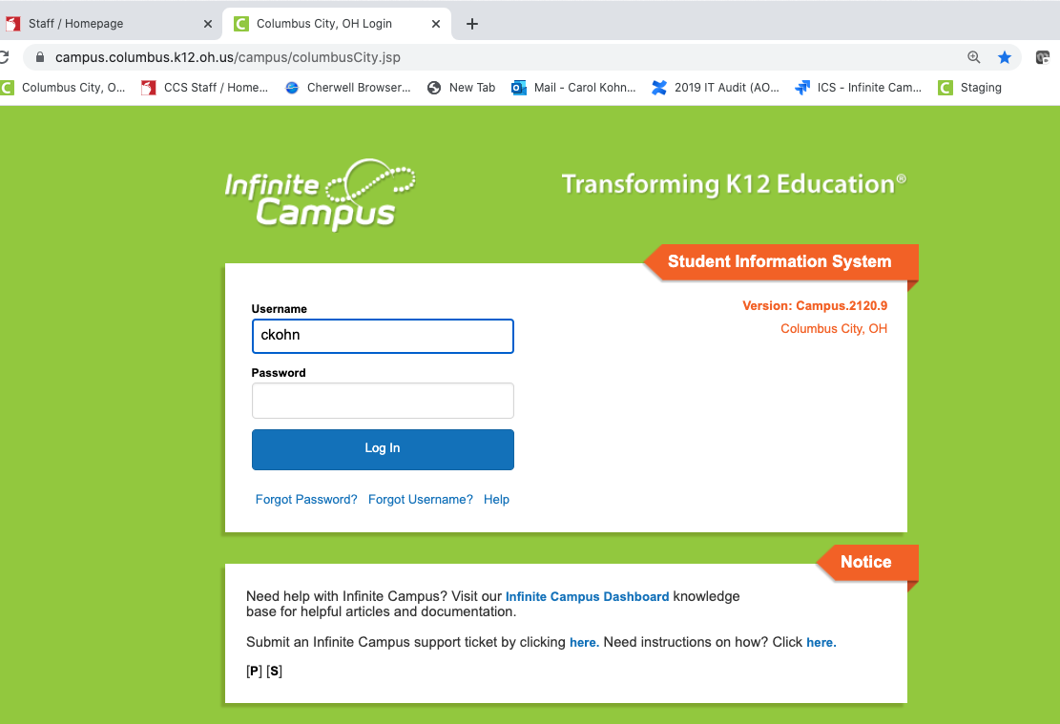
Same username and password as your email
Notes:
Use the same username and password as your email. Every time you change your login it will change for Infinite Campus as well.

Slide 4
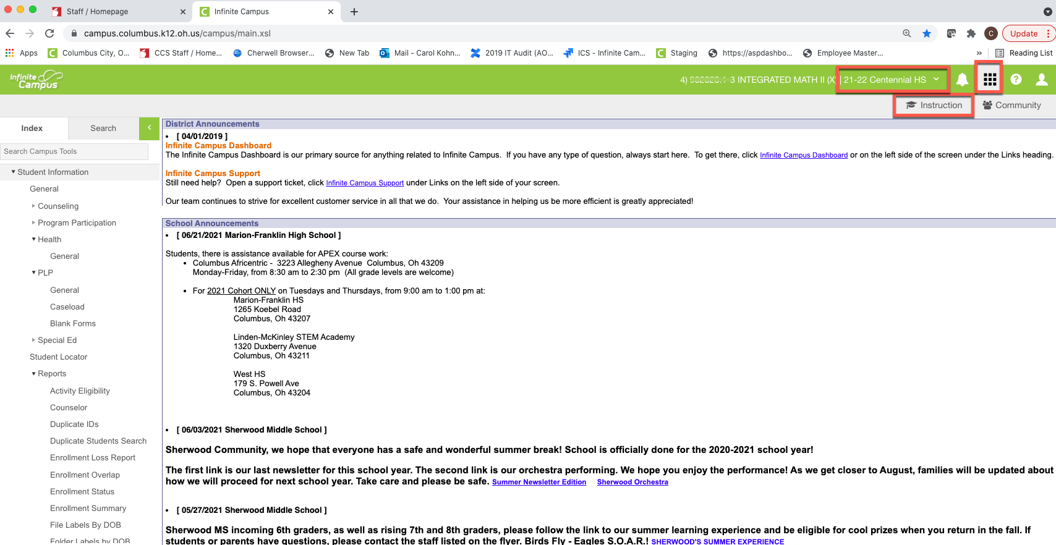
Campus Instruction vs Campus Tools
Notes:
Check to see that you have the correct school and school year at the top of the screen. Click on the App Switcher (looks like 9 little boxes) and select Campus Instruction. If there is not a Grade Book link on the left side of your screen you are in Campus Tools, and not Campus Instruction. You can change how your screen opens in settings so that you are automatically directed to Campus Instruction when you log in.

Slide 5
Campus Instruction/Gradebook
The Grade Book tool allows teachers to enter assignments and scores to their classes (sections). In addition, it provides visual representations of student performance and will calculate the quarter grades to produce a Final Grade.
The Grade Book tool displays course section (class), term (quarter), & grading task (6-12) or standard (K-5) based on the selections made in the dropdowns.
Notes:
Clicking on the dropdown on ‘Instruction’, we can switch back to Campus Tools. In Campus Instruction, we can see the option to click on ‘Gradebook’. In this screenshot we can see that the gradebook has been set up and we can see grades and assignments for this section.

Slide 6
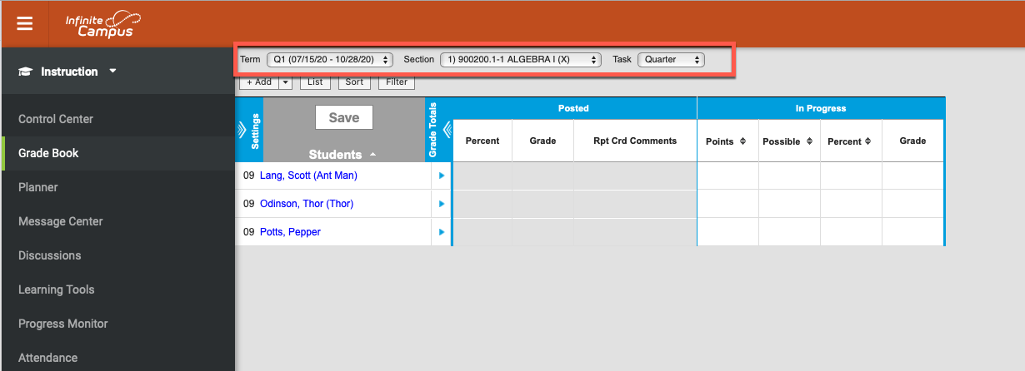
The Grade Book tool displays course section (class), term (quarter), & grading task (6-12) or standard (K-5) based on the selections made in the appropriate dropdowns.
Notes:
In this screenshot, we can see that the gradebook set up has not yet begun. We don’t see any grades or assignments yet. Each section of this course will need to be ‘set up’ to function properly to see grades and assignments.

Slide 7
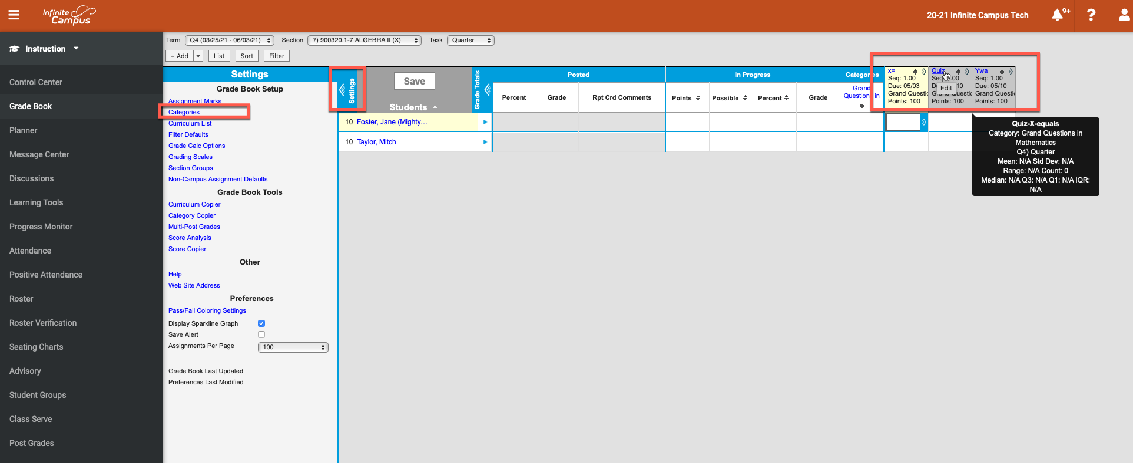
Click on Settings>Create Category>Add an Assignment
1. Click settings to see the Grade Book Setup links. These allow teachers to manipulate how assignments are categorized and scored.
2. You MUST have at least one Category to be able to create an assignment.
3. Add an assignment
Notes:
To begin setting up your Grade Book, you must create at least one category. A category is where your assignments will live. You can make multiple categories, or only one. Multiple categories could include Homework, Labs, and Tests
Verify the Term, Section, and Task.
Click Settings. The Settings option will expand.
Click the blue Categories link. The Categories List will appear.

Slide 8
Create the Category First
Notes:
Click the ‘Add’ button on the ‘Category List’ screen.

Slide 9
Summary of items we have covered so far. We will add and assignment in just a bit.
Campus Instruction vs Campus Tools
Gradebook Tools
Creating a Category
Items we will cover next.
Creating Grade Calculations for 6-12 secondary grades
Adding an Assignment
Posting Grades with Grade Calculations vs Post Grades for K-5 Standards

Slide 10
Create Grade Calculations
Open Settings
Click on Grade Calc Options
A Grade Calculation window will open.
Notes:
NOTE: You need to do this for every section:
In the Grade Book, click on Settings.
Click on Grade Calc Options
A Grade Calculation window will open.

Slide 11
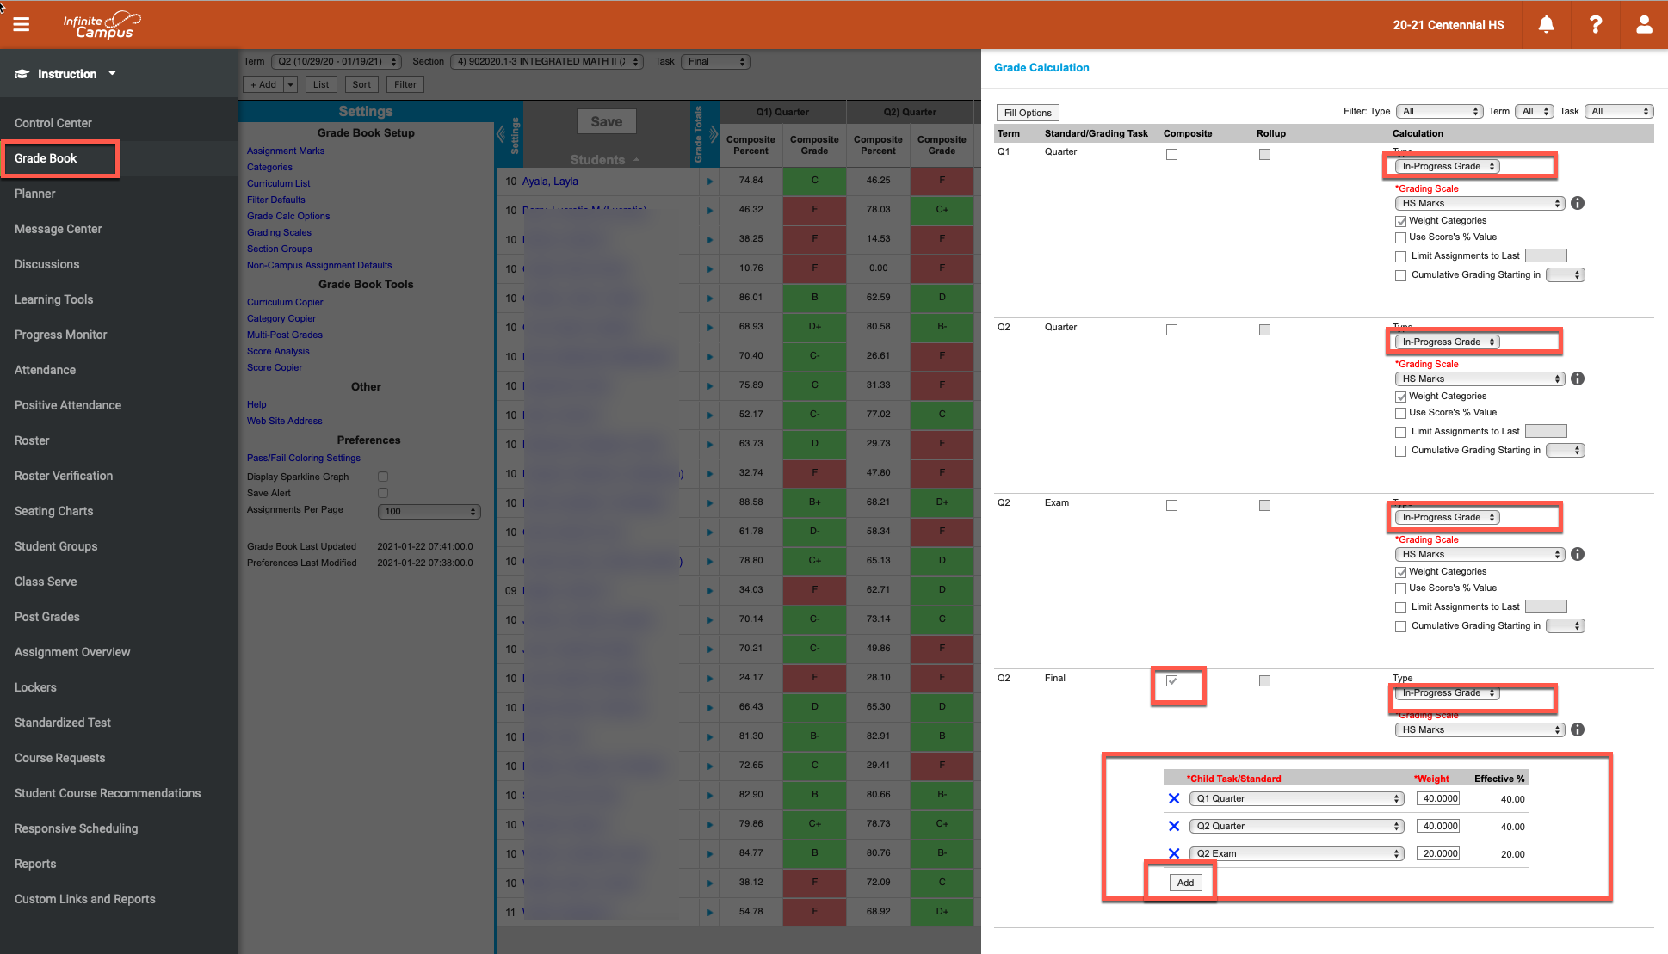
Choose Grade Calc Options
Grading Scale: From the drop-down menu, select MS Marks or HS Marks as applicable.
Weight Categories: If you entered weights for your categories, check the box.
Fill calculation Type: From the drop-down menu, select ‘In Progress’ grade.
Notes:
Fill calculation Type: From the drop-down menu, select ‘In Progress’ grade.
Grading Scale: From the drop-down menu, select MS Marks or HS Marks as applicable.
Weight Categories: If you entered weights for your categories, check the box.
Use Scores Percent Value: MOST PEOPLE WILL NOT SELECT THIS OPTION. If this box is checked every assignment is counted equally. For example, the 10 point homework assignment and the 100 point test are counted the same in a student’s nine weeks grade. In other words, a student who earned a 10/10 and a 50/100, no longer has a 60/110, or 55%, but rather a 100% (10/10) and a 50% (50/100), and therefore has a 75% average for the nine weeks:
Scoring by points: 10/10 + 50/100 = 60/110 = 55% or an F.
Using Scores Percent Value: 10/10 = 100%; 50/100 = 50% = average of 75% or a C.
If using this option, all assignments must be worth more than 0 points.
Never click both (Weight and Scores Percent). If you are doing straight points you most likely do not want to select either one.
The options selected will fill for all grading tasks for the class.
Using the scroll bar, scroll to the bottom of the window. Click the checkbox on the Final Grading task.
The Child Task/Standard displays indicating how the final grade will calculate in the
Grade Book.
For Semester and year-long courses, the weight of the quarter grade will display (the weights must add up to 100).
The Weight of the Exam grade displays as well.
If no exam grade is entered, the quarter grades will be weighted equally for the Final grade.
Do this for every section.
Click Save.

Slide 12
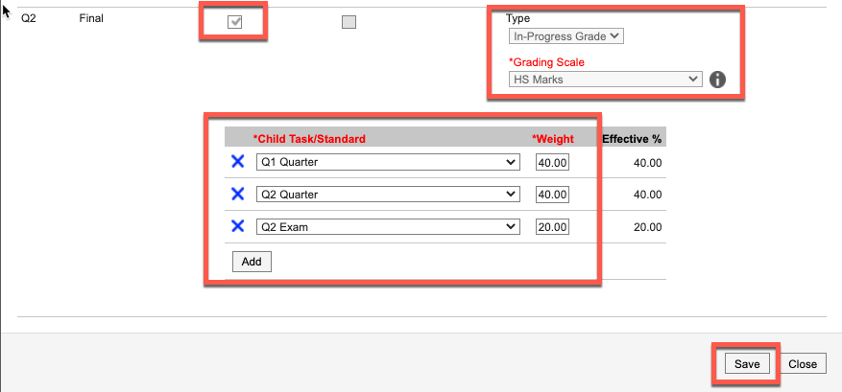
Final Task Must Include Calculation
Notes:
The Final Grading task must include the terms and weights for the final grades to calculate.
Sounds simple, right?? But 90% of our helpdesk tickets at the end of the semester or end of year include teachers that do not see any grades to post. The reason is that they have failed to tell the application how to calculate the grades.
Clicking the checkbox on the Final Grading Task will open the quarter tasks so that you can enter the weights for the quarter grades to calculate (add up to 100%).

Slide 13
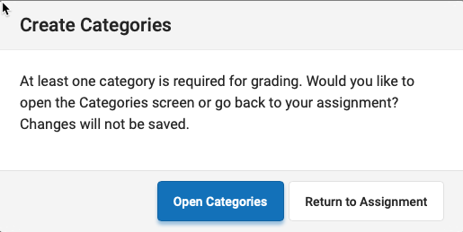
Creating Assignments
Notes:
Creating Assignments (Reminder: if you have not created a category, you will receive a message saying that your assignment will not be saved.)
Verify the Term, Section, and Task where you want the Assignment added.
Click Add to add an assignment.

Slide 14
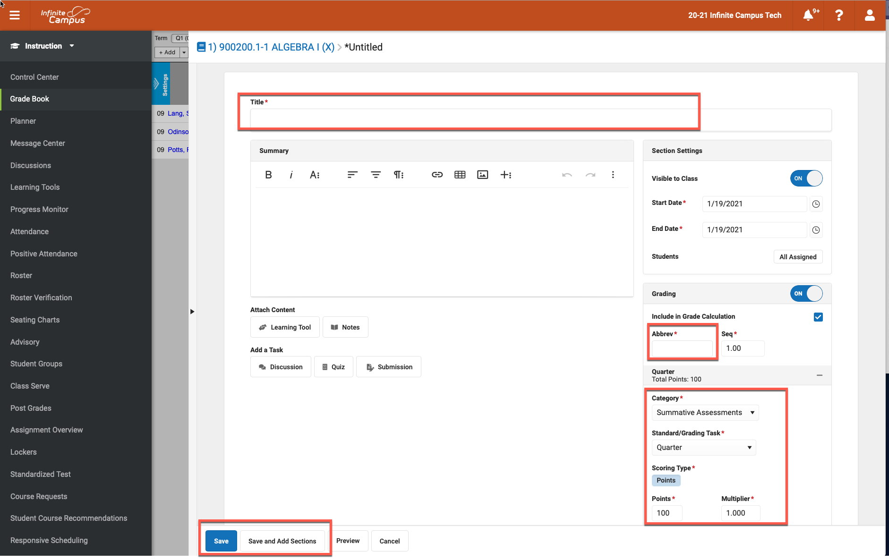
Naming and Saving an Assignment
Notes:
Assignment Title: Enter the complete name for the assignment.
Visible to the Class is checked ‘ON’ by default. Click to ‘OFF’ to prevent the assignment from displaying in the student and parent portal.
Start and End Date auto-populates the current date. They can be changed to reflect when students receive the assignment and to reflect when students need to turn in the assignment. NOTE: If the Due date is in another Quarter, the Assignment will display in the Grade Book in that Quarter.
Include in Grade Calculations is checked by default, uncheck to exclude the assignment in the calculations of the student’s score.
Abbrev an abbreviated name appears automatically but can be edited.
Choose the Category, Grading Task & Scoring/Points
Use the dropdown arrows to select the Category and the Grading Task. The Categories aligned to the Grading Task and the Grading Task aligned with the course will display. Select the appropriate Category and Grading Task.
Enter the Total Points possible. The Multiplier determines how the assignment affects the students’ grades. For example, a 50 point assignment with a Multiplier of 2 counts as a 100 point assignment.
Click Save or Save and Add Sections: Clicking ‘Save and Add’ will allow you add the assignment to other sections(classes) without leaving the assignments screen.
Click Save Changes to save the assignment and close the Assignment Detail window. You should be able to see the assignment you just created once you save it. (If you do not see it make sure the drop-down grading task menu is showing Quarter and not Final.)

Slide 15
Save and Add Assignments to Sections
Notes:
Clicking Save and Add Sections: Clicking ‘Save and Add Sections’ will open the Section Editor screen. This screen allows you add the assignment to other sections(classes) without leaving the assignments screen.
Click Add and ‘OK’ to copy it to other sections or courses.
Click Save Changes to save the assignment and close the Assignment Detail window. You should be able to see the assignment you just created once you save it. (If you do not see it make sure the drop-down grading task menu is showing Quarter and not Final.)

Slide 16
Scoring Assignments
Notes:
Grading/Scoring Assignments
Click the chevron symbol to the right of the assignment abbreviation or within the score grid to expand the detail information for that assignment. **Click the blue Assignment Name link (or the blue Assignment Name link abbreviation when the assignment is collapsed) to open the assignment where modifications can be made.
Enter the score in the first column.
Comments can be entered regarding the student’s score on the assignment.
The assignment can be marked as follows:
T=Turned In (assignment will display as due in the portal unless marked as turned in);
M=Missing (counts as a 0 even if a score is entered);
There is a Missing Grades Report and Class Messenger if the M is utilized
L=Late; I=Incomplete;
Ch=Cheated (counts as 0 even if a score is entered;
X for Exempt (the assignment will not calculate into the student’s grade);
Dr=Dropped (the assignment will not calculate into the student’s grade).
Click Save

Slide 17
Posting Secondary Quarter Grades 6-12
Notes:
Posting Secondary Grades
To post grades from the grade book to a Quarter report card
In Campus Instruction, click Grade Book on the Action Bar.
Select the Term/Quarter.
Select the Section (Class).
Use the drop-down menu to select Quarter or Final grading tasks to enter grades.
Click on ‘Post Grades’ on the left side of the screen.
In the ‘In Progress’ section of the Grade Book, when the grading window is open, ‘Post’ will display in orange above the Grade column. Click Post.
The Term will default to the Term displayed in the Grade Book. Use the drop-down to select another Term, if needed. For posting Quarter Grades select Quarter. Click OK.
A Warning window will open ‘Grades will be posted upon save.’ Click OK.
For Quarter Grades, you will be directed back to the Grade Book main page. Be sure to hit the Save Button which should now be red.
NOTE: If there are no grades in the Post Grade column, check to be sure that you have ‘Grade Calc Options’ set to ‘In Progress’ for that course section/period.

Slide 18
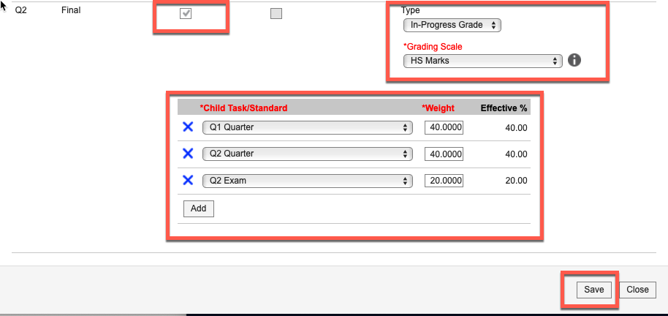
Posting Secondary Final Grades 6-12
Notes:
Posting Final Secondary Grades
In the ‘In Progress’ section of the Grade Book, when the grading window is open, ‘Post’ will display in orange above the Grade column. Click ‘Post’ and then ‘Save’. (See NOTE below)
A Warning window will open ‘Grades will be posted upon save.’ Click OK.
For Quarter Grades, you will be directed back to the Grade Book main page. Be sure to hit the Save Button which should now be red.
NOTE: If there are no grades in the Post Grade column, check to be sure that you have ‘Grade Calc Options’ set up for that course section/period. Check the Composite box to see the Child Task in order to set the calculations for the Final Grade.

Slide 19
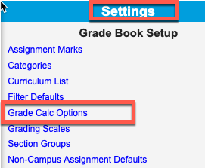
No Set Up in Grade Calc Options…. No ‘In-Progress’ grades to post.
Notes:
If you do not have your Grad Calc Options set up to tell the computer how you want those grades to calculate, you will not see grades to Post.

Slide 20
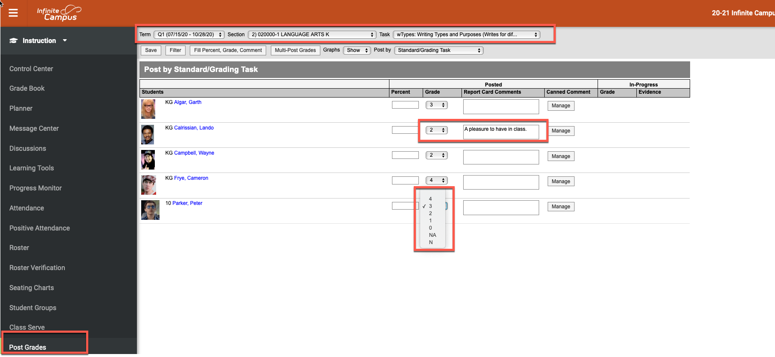
Posting Grades for Elementary K-5 (Standards)
Notes:
Posting Grades K-5 (Standards)
To enter marks for ‘Standards’ for students in Kindergarten through fifth grade to show on a report card
In Campus Instruction, click ‘Post Grades’ on the Action Bar (left side of the screen).
Select the Term/Quarter.
Select the Section (Class).
Use the drop-down arrows on the ‘Grade’ field to choose the correct grade for the standard.
If you choose enter the report card comment. There are canned comments available in ‘Settings’.
The ‘Save’ button will turn red. Click the ‘Save’ button to save the grades and comments.
Warning: If you enter all the grades and do not click the ‘Save’ button, the grades will NOT save.

