Slide 1
Payroll Office
Presented August 2018

Slide 2
Organization
Stanley Bahorek, Treasurer, CFO
Michael McCammon, Controller
Betty Arey, Payroll Administrator

Slide 3
DISTRICT EMAIL
Please encourage ALL staff in your building to check their CCS email regularly at work or at home.
Confirmation of changes made in ESS will be sent to your email address.
Payroll and Benefits send email broadcasts throughout the year.

Slide 4
KRONOS
ALL CLASSIFIED must swipe!
Training videos are available on the Intranet
Full training for new timekeepers and approvers
Short segments for specific topic refresher
ALL KRONOS must be complete and approved by 10:00 p.m. Monday
Shortages reported to Payroll with corrective action by noon on Tuesday of pay week will be direct deposited on pay day.
Corrective information received after noon on Tuesday will be corrected via direct deposit on the following pay day.
Hourly certificated staff will report time through KRONOS

Slide 5
Holiday Pay
Eligibility for holiday pay:
You must be in a pay status the day before the holiday and the day after.
Pay status – you worked or used leave for any portion of the day

Slide 6
Submitting Extra Service and Overtime
All extra service and overtime must be captured in Kronos with badge swipes.
If the extra time is immediately after your regular schedule do not swipe out.
If there is a break in time between your regular schedule and extra time,
you must swipe out, swipe in and swipe out again.
The timesheet must be submitted to Payroll when the source of funding is
different than your regular assignment.
i.e. CPI training – swipe Kronos and send a timesheet.
The supervisor will know the funding source and remit the timesheet when
required.

Slide 7
Parent Teacher Conferences
The two evenings must capture your number of hours per day to keep you in a pay status for the “day off”.
Example 1 – you work 4.0 hours each of the evenings, you will receive full pay for the day off.
Example 2 – you work 2 hours one night and 3 hours the second night, you will receive 5 hours of pay for the day off unless you use personal leave.

Slide 8
Leave balances on the Kronos time clock?
Yes, you can see your leave balances on the Kronos time clock!
At the time clock:
Hit the blue button to the left of “view accruals online”
Swipe your badge
A screen will pop up; hit enter twice
Your totals will pop up on the screen.
Use up/down arrows under the screen to scroll through your totals
6. ESC key to exit

Slide 9
Vacation - Am I at Use or Lose?
You may view your leave balances on your pay statement and the Kronos time clock.
The accrual of additional hours occurs between the first and second pay of the month.
If you are at use or lose, you should talk with your supervisor to schedule your vacation. Remember to let your supervisor know you are at “use or lose”.
Do not wait until you are at the maximum. If the “use” is during the pay period being processed for the second pay, the accrual occurs before the posting of usage and you may lose your accrual.

Slide 10
I’ve Been Called to Jury Duty What should I do?
Send your notice to Human Resources as soon as you receive it.
You will be granted Jury Duty pay for the days the court requires your attendance.
The court will pay you for the days you report and we will pay you for the days you report.
You must endorse your check from the court and turn it into payroll.
We are required to dock your pay for the days you serve if you do not submit the check to payroll

Slide 11
Are You Thinking About Retiring?
It is very important that you follow the steps below exactly:
Contact the School Employees Retirement System to meet with a counselor to inquire about your monthly SERS income and health care cost.
Submit a hand written letter of resignation to Human Resources. Emails, faxes,
etc. will not be accepted.
3. Make your retirement date the last day of the month as SERS will not pay
retirement dollars for a month in which you worked even a day.
4. READ the retirement and severance pay information found on ESS under
resources.

Slide 12
Severance Pay
So, you have decided to retire and want to know how much you will receive in severance pay.
Print your most recent pay statement
Access the severance pay estimator under Resources on Employee Self Service
Enter your hourly rate and leave balances on your latest pay statement into the estimator.
Remember you must give 90 day notice to receive enhanced severance pay

Slide 13
EMPLOYEE VERIFICATIONS
theworknumber.com provides CCS employees, lenders and/or social service agencies with employment verifications.
theworknumber.com
or call 1-200-367-2884
You’ll need:
Employer Code: 14232
Your SSN
Your Pin (Last 4 SSN + 4 Digit Birth Year)
This information is also located on ESS under Resources.

Slide 14
TAX SHELTERED ANNUITIES – 403b
IRC 403(b) Tax-Sheltered Annuity Plans
A 403(b) plan (also called a tax-sheltered annuity or TSA plan) is a retirement plan offered by public schools. Employees save for retirement by contributing to individual accounts.
Choosing a Retirement Plan: 403(b) Tax-Sheltered Annuity Plan
A 403(b) plan (tax-sheltered annuity plan or TSA) is a retirement plan offered by public school districts. The deferred salary is not subject to federal or state income tax until it's distributed. However, a 403(b) plan may also offer designated Roth accounts. Salary contributed to a Roth account is taxed currently, but is tax-free (including earnings) when distributed.
As a public school employee you are eligible to participate.
Contribution limits
Total contributions to each employee’s 403(b) account or annuity are limited based on IRS regulations.
Accessing your funds
Access to your funds is limited and can be explained by the agent you select.

Slide 15
TAX SHELTERED ANNUITIES - 457
IRC 457(b) Deferred Compensation Plans
Plans of deferred compensation described in IRC section 457 are available for public school employees. Employees save for retirement by contributing to individual accounts.
Contribution limits
Total contributions to each employee’s 457 annuity are limited based on IRS regulations.
Accessing your funds
Access to your funds is limited and can be explained by the agent you select.

Slide 16
TAX SHELTERED ANNUITIES
Your chosen agent can help you:
Determine your retirement income needs
Evaluate your current financial picture
Evaluate combining all your assets into one program
Present a variety of withdrawal scenarios
The terms of the Columbus City Schools’ Plan may be more restrictive than the IRS dictates.
The terms of Columbus City Schools’ Plan document and governing statutes prevail.

Slide 17
STARTING YOUR ANNUITY
The list of approved annuity companies is found on ESS under Resources
You must complete the Salary Reduction Agreement and submit the document to Plan Connect.
Plan Connect information is found on ESS under Resources, look for the welcome kit.

Slide 18
CANCELLING YOUR ANNUITY
To stop your deduction you must complete the cancellation through Plan Connect

Slide 19
To locate Payroll related forms go to:
Intranet
Department
Treasurer’s Office
Payroll
Choose your form
Print

Slide 20
EMPLOYEE SELF SERVICE (ESS)
View pay statements from just about anywhere:
On vacation
During summer, winter and spring break
At your lending institutions
Even on your smart phone
We suggest you check your pay statement each Monday of pay week.

Slide 21
Important Facts About Employee Self Service
Employee Self Service is a wealth of information for all employees.
It may be accessed from anywhere, on any device. We suggest you view your pay statement every Monday of pay week.
Enter or change your W-4 filing status and or number of exemptions
ESS will show the effective date of your change.
You can use the pay check simulator before making the changes to see how it
will affect your pay. However, please remember that the simulator is simply a tool, it
doesn’t make the change for you.
Obtain copies of any pay statement issued since April 6, 2012
Obtain copies of any W-2 issued since 2012
Update your address
Name changes must be documented in Human Resources
Pay plan change forms will be available each year under Resources
School District Income Tax (SDIT) form is now completed online. The form is under Resources.
Sick Leave Cash Conversion forms will be available under Resources

Slide 22
JOHN DOE

Slide 23
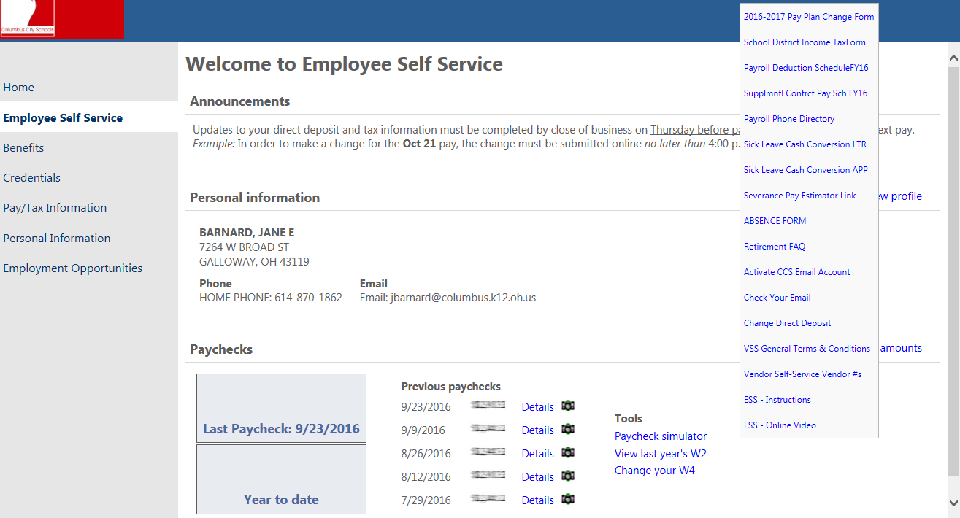
JOHN DOE
270 E STATE ST
COLUMBUS OH 43215
614-365-5000 Ccityschools@coloumbus.k12.oh.us

Slide 24
SUMMARY
SWIPE, SWIPE, SWIPE – NO EXCEPTIONS
VIEW YOUR PAY STATEMENT ON ESS EVERY MONDAY BEFORE THE PAY DATE. REPORT POSSIBLE KRONOS ISSUES TO YOUR TIMEKEEPER/APPROVER ASAP.
APPROVERS MUST REPORT CORRECTIVE INFORMATION TO PAYROLL BEFORE NOON ON TUESDAY BEFORE PAY DAY.
EXTRA SERVICE AND OVERTIME MUST BE SUPPORTED IN KRONOS.
YOU MUST BE IN “PAY STATUS” TO RECEIVE HOLIDAY PAY.

Slide 25
HAVE A GREAT YEAR!

