Slide 1
Saving The Spreadsheet In The Correct Location
HOW TO LOCATE YOUR SCHOOL’S DIGITIZATION FOLDER AND SAVE YOUR SPREADSHEET CORRECTLY
CREATED BY: SARAH DELOZIER

Slide 2
SAVING THE SPREADSHEET IN THE CORRECT LOCATION
If you are unsure how, and where, to properly save the Inactive Student Records Digitization Spreadsheet (in its original Excel Format) this tutorial will provide a better understanding of what is expected.
Each Columbus City School has its own folder in the Secretary Shared file on the O:Drive. Inside each individual school folder is a Digitization sub folder for that specific school only. This will be the location that spreadsheet is to be saved. (DO NOT save the spreadsheet anywhere else, or in any other format, as this will be the location in which the Digitization Secretary will be looking.

Slide 3
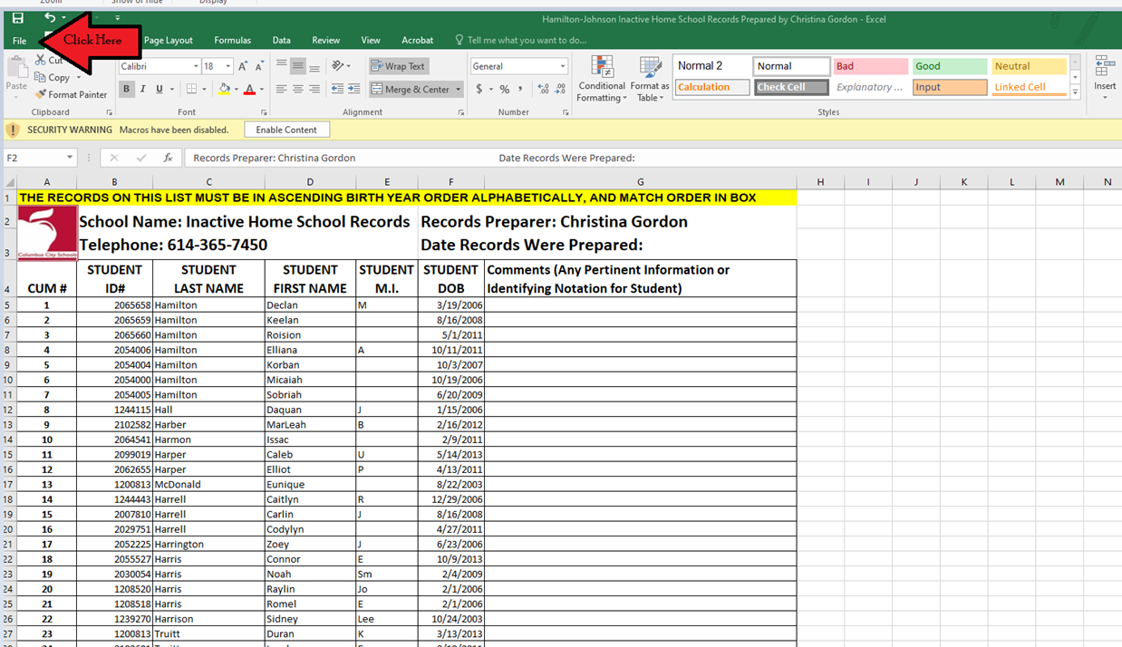
SAVING THE SPREADSHEET IN THE CORRECT LOCATION
The RED ARROWS are pointing to each location on the screen where each step explained is referring to in this PowerPoint.
When the spreadsheet is completed, click on:
File

Slide 4
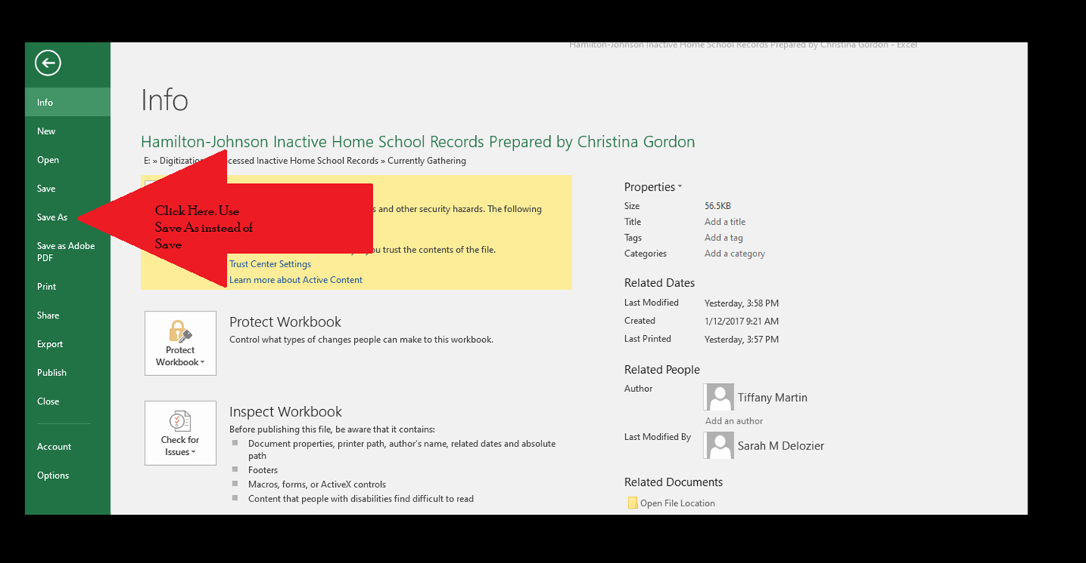
SAVING THE SPREADSHEET IN THE CORRECT LOCATION
Click on:
Save As

Slide 5
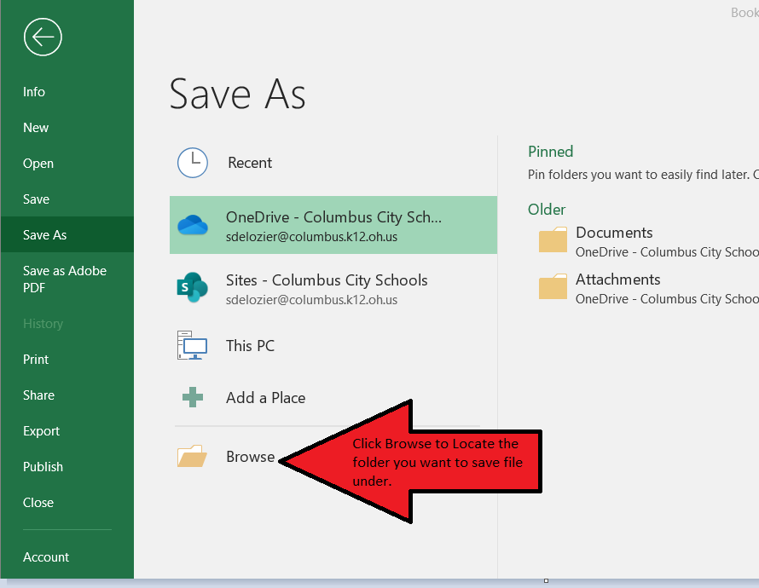
SAVING THE SPREADSHEET IN THE CORRECT LOCATION
Click on:
Browse

Slide 6
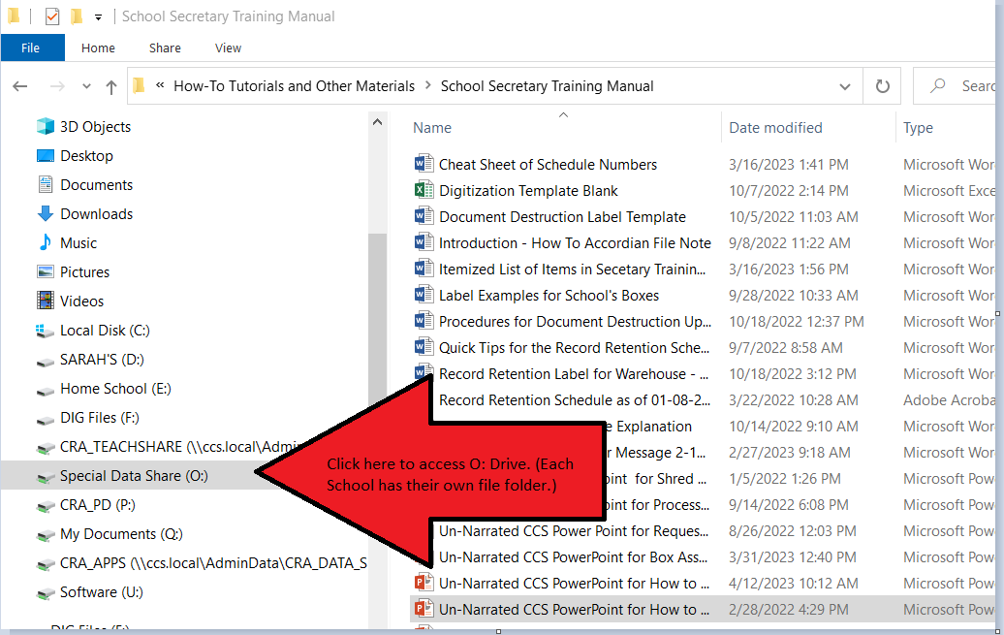
SAVING THE SPREADSHEET IN THE CORRECT LOCATION
Click on:
Special Data Share (O:)

Slide 7
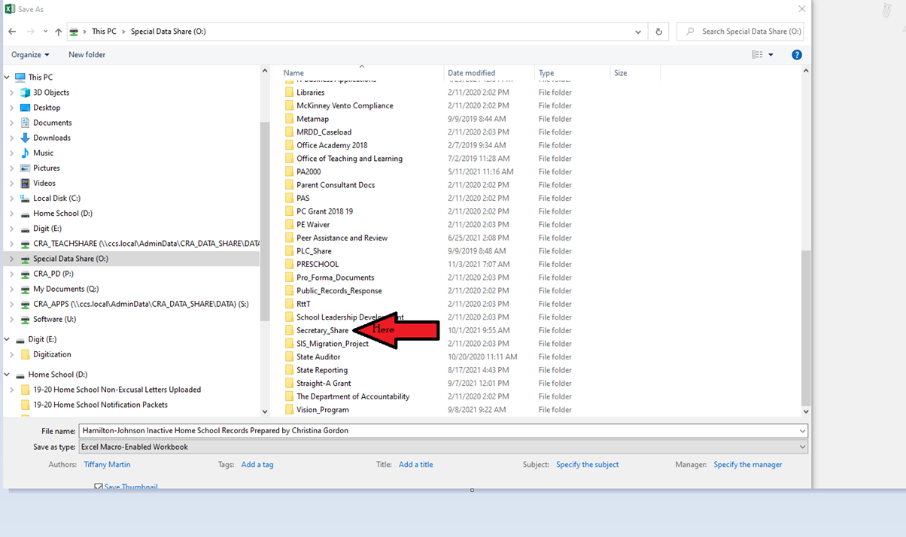
SAVING THE SPREADSHEET IN THE CORRECT LOCATION
Click on:
Secretary_Share

Slide 8
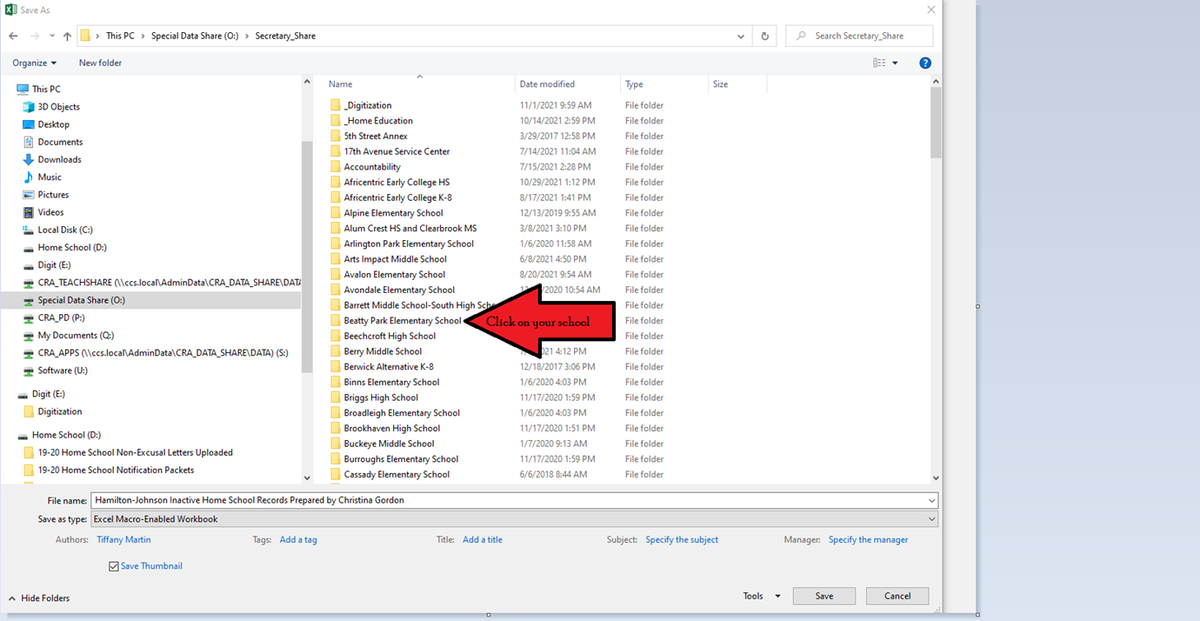
SAVING THE SPREADSHEET IN THE CORRECT LOCATION
Click on:
Your Specific School Name
This is the school that the records belong to.

Slide 9
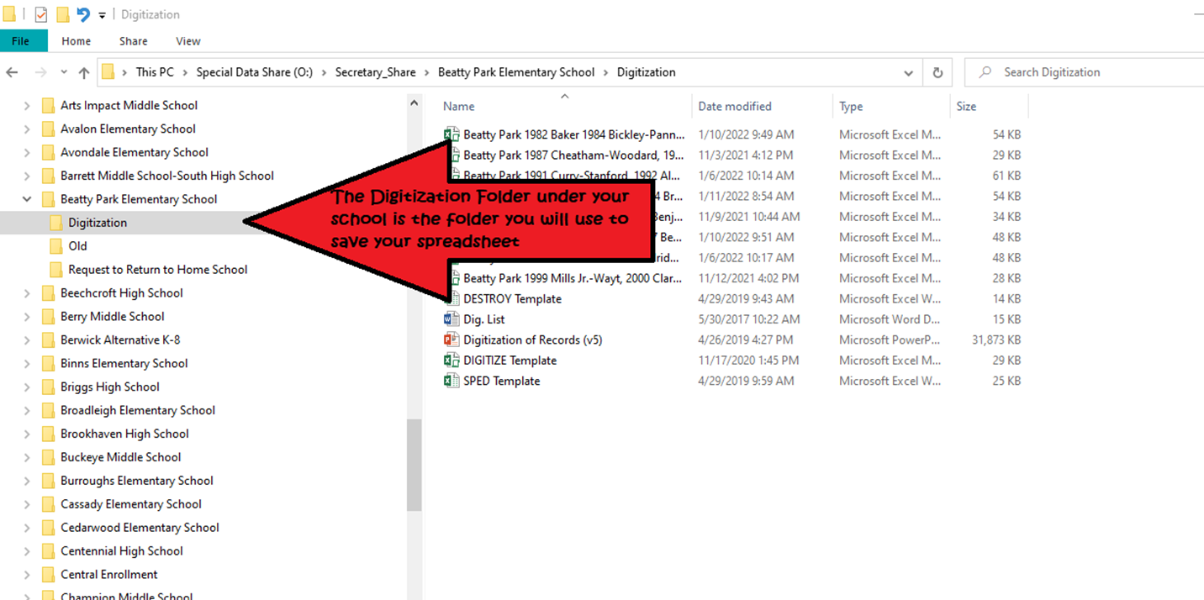
SAVING THE SPREADSHEET IN THE CORRECT LOCATION
Each School has a Digitization Folder. This is where your spreadsheet will be saved.

Slide 10
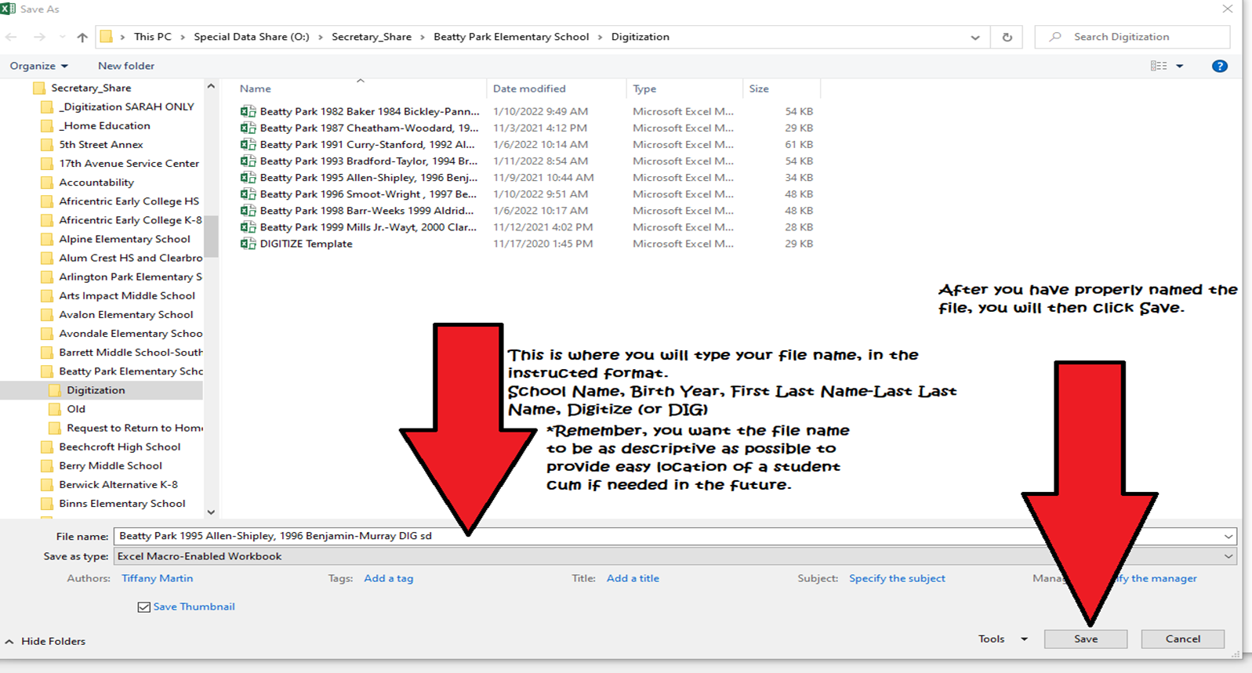
SAVING THE SPREADSHEET IN THE CORRECT LOCATION
The File Name will be specific to each spreadsheet. It must list the school name, the birth year, and the names from start to end of each birth year contained on each spreadsheet.
*DO NOT CREATE MULTIPLE SPREADSHEETS FOR ONE BOX.
EACH BOX MUST HAVE ONLY 1 SPREADSHEET THAT LISTS ITS CONTENTS. DO NOT MAKE AN INDIVIDUAL SPREADSHEET FOR EACH BIRTH YEAR THAT MAY BE IN ONE BOX.

Slide 11
SAVING THE SPREADSHEET IN THE CORRECT LOCATION
I hope this has answered any questions or concerns you may have had. If, at any time, you are unsure of the steps that you should take, please do not hesitate to reach out. The Digitization Secretary is always ready and willing to assist you with anything you may need.
Sarah DeLozier Office: 380-997-7335 or 614-365-7450
Sarah DeLozier Personal Cellphone: 614-266-2362

