Slide 1
Requesting a Transfer of Records
Sending Records to Digitization

Slide 2
Before reviewing the following pages on Requesting a Transfer of Records, Please click on the “Previous Intranet Site” as seen here in the picture. If you do not, this Power Point will not be as helpful as intended.

Slide 3
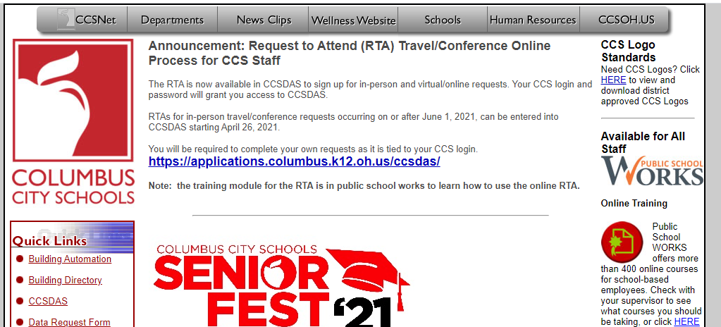
Requesting Transfer of Records
Once approval from The Division of the Registrar is received, send boxes to Digitization at Central Enrollment
Go to the CCS Intranet
At the top of the page, click on “Departments”

Slide 4
Requesting Transfer of Records
Select Purchasing, Delivery Services, Print Services, and Warehousing

Slide 5
Requesting Transfer of Records
Select Delivery Services Work Request (DSWR)

Slide 6
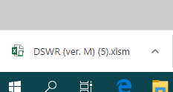
Requesting Transfer of Records
Once selecting DSWR, a small box will appear at the bottom of the screen. It is the downloaded document. This is what it will look like:

Slide 7
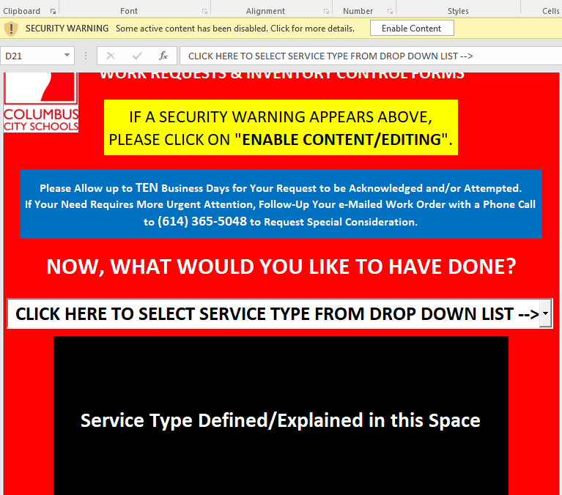
Requesting Transfer of Records
When this document opens, click on the Enable Content button in order to make the appropriate selection.
Enable Content button

Slide 8
Requesting Transfer of Records
Select the appropriate drop down from:“Click Here to Select Service Type From Drop Down List”
Click here to make selection

Slide 9
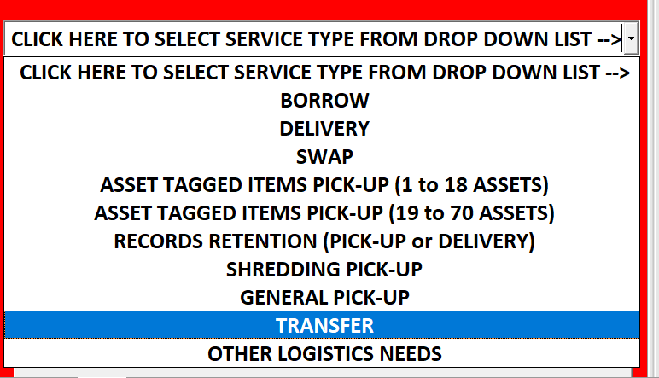
Requesting Transfer of Records
Select Transfer.

Slide 10
Requesting Transfer of Records
After selecting “Transfer”, click on gray box to proceed.

Slide 11
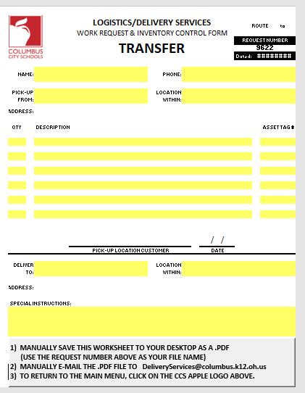
Requesting Transfer of Records
Records are to be sent to:
Central Enrollment Center
Garage.
Special Instructions:
“Deliver to Garage for Storage”
This is the Request Number.
This is the requestor’s information
This section is for a description of what is being transferred
Once the Transfer is scheduled, please put some type of marker on outside of box, stating the school’s name (original location of records being sent.)
This is the location the records should be delivered to (Central Enrollment Center Garage).
Follow Instructions in Gray Box to Finalize Request

Slide 12
Requesting Transfer of Records
Once the Transfer Request sheet is saved as a PDF, with file named only by the Request Number, email it to DeliveryServices@columbus.k12.oh.us with that same Request Number in the subject line.
Print a copy and place it with the box(es) that is/are being transferred.
Forward a copy of the Work Request to the DivRegistrar@columbus.k12.oh.us email also.
Please make a notation on each box, stating the school’s name, or the original location of those records if the school is closed.

Slide 13
Questions
If you have any questions about this process, please do not hesitate to reach out for assistance.
DivRegistrar@columbus.k12.oh.us
sdelozier@columbus.k12.oh.us
Office: 380-997-7335
Personal Cellphone: 614-266-2362

