Slide 1
Document Shredding
Shred Authorization Form and Pickup Request for Writing Portfolios

Slide 2
Before reviewing the following pages on Document Shredding, Please click on the “Previous Intranet Site” as seen here in the picture. If you do not, this Power Point will not be as helpful as intended.

Slide 3
Understanding Document Destruction and Record Retention
General Description of Document Destruction as a whole
WHAT: Any document that reaches the time allowed for destruction, per the Records Retention document, must always be accounted for through documentation. Different categories of records must be retained for different amounts of time. Each category of documents has its own Schedule # and Retention Period. Before shredding anything, first review the Record Retention Schedule to ensure that items are being kept the appropriate amount of time, and not destroyed before it is approved to do so.
How: Example of how to interpret Record Retention Schedule: The school’s Visitor Log, that is maintained by main office, is used for anyone that is signing into, or out of, the school at any given time. According to the Record Retention Schedule, the Schedule Number for the Visitor Log is #133. The retention period for these forms is One School Year. Those logs must be maintained for that amount of time, after which they can be destroyed. It is always important to refer to the Record Retention Schedule before destroying any document. If the school is under audit/inspection, they will ask for those documents.

Slide 4
Record Retention Schedule
The Record Retention Schedule provides information about the schedule type, a description, and how long records need retained. This document can be found on the CCS Dashboard.
The only items that are to be shred during this process are student Writing Portfolios. Those are not contained within the Record Retention Schedule and may be shred when student is inactive. This information is here to explain the whole process in case there is a need to shred other documents unrelated to Processing Records to be Digitized.

Slide 5
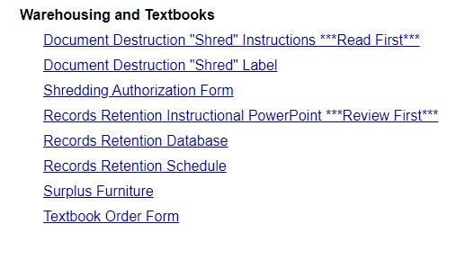
Record Retention Schedule
A copy of the Record Retention Schedule can be found here. Follow the same steps that were taken to locate the Document Destruction “Shred” Label, and that is where to locate this document.

Slide 6
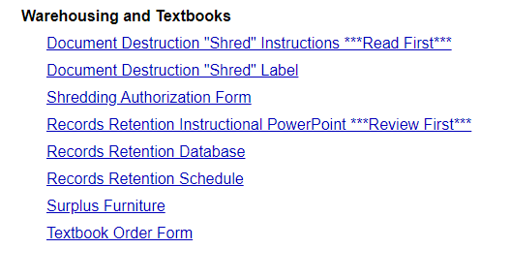
Document Destruction: Required Materials
A copy of the Shred Label can be found on the CCS Intranet by selecting Departments and scrolling down to the Warehousing Textbooks section.
The labels that are to be used are the Avery 8126 Internet Shipping Labels. They are “half sheet labels”, meaning 2 per sheet. These can be ordered from Friends, and cost is $7.20 for box of 50 sheets. (price subject to change)
Each box should have only 1 of these labels attached to either end of the box.

Slide 7
Document Destruction Supplies
The label format may change over time, but the information required should stay the same. For any questions about the template, or information that is needed, please contact Delivery Services.
After detailed description is typed on label, at the bottom of the description box type “DESTROY (date to be destroyed)” as large as space will allow, like pictured in sample. This makes it easily known when that box can be destroyed and easier on the warehouse.

Slide 8
Document Destruction Supplies
The box that is required by the warehouse for Document Destruction can be ordered from the Warehouse, directly, using:
Order Number: 800005 General Purpose Box Box size: 18”L x 12”W x 10”H 25 per bundle for $20 (Price Subject to Change)
If ordering from Friends:
Order Number: BOX181210R
20 per bundle for $30.89 (Price Subject to Change)

Slide 9
Creating Shred Authorization Form
Once the boxes are ready and labeled, create a Shredding Authorization Form. The warehouse will not destroy the documents without a signed copy of this form. The person that is to sign this document is the person that has authority within the school. This most likely would be the Principal. To create this document go to:

Slide 10
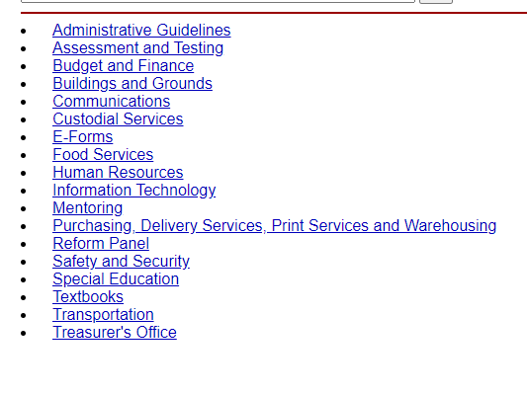
Creating Shred Authorization Form

Slide 11
Creating Shred Authorization Form
Once “Delivery Services Work Request (DSWR)” is selected, a box will pop up on the bottom left of the screen will appear. This is the downloaded document. Click on this.

Slide 12
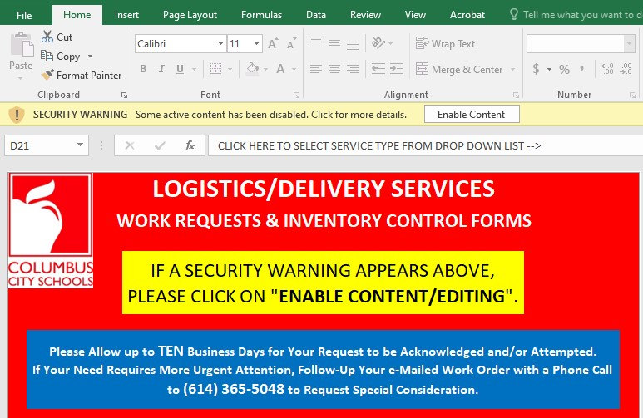
Creating Shred Authorization Form
After clicking on the downloaded document, click on Enable Content button at the top of the document.
Once the content is enabled, select the type of service that is being requested.

Slide 13
Creating Shred Authorization Form
Using the drop down box, select Shredding Pick-Up

Slide 14
Creating Shred Authorization Form
At the bottom of that screen this box is located. Like the description states, click on this once the selection of requested task has been chosen.

Slide 15
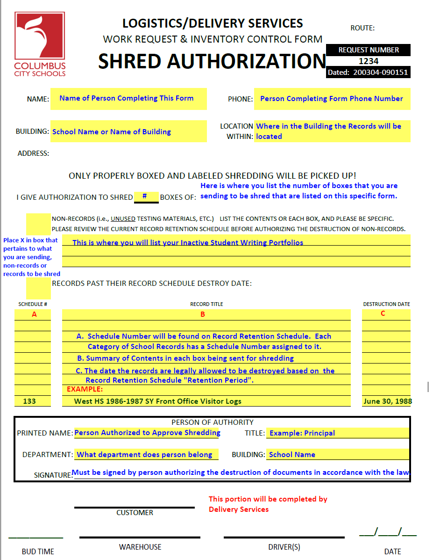
This is the Shred Authorization Form. The identifying marker for this specific form is the 4 digit Request Number located in upper right corner. On this sample, that number is 1234. The title of this form, when saving into files and emailing to Delivery Services, should be this Request Number, as this document is the only one that will be assigned that number.
Creating a file for all Delivery Services Work Request forms is highly recommended.
Descriptions of the information to be entered is displayed in blue.
The warehouse will not shred or destroy any documents that are sent to them without this form included.
If you have any questions regarding the completion of this form, do not hesitate to reach out to Digitization for guidance.

Slide 16
Creating Shred Authorization Form
At the bottom of the Shred Authorization Form the gray box will provide the information needed to complete the process and request the pick-up of the boxes.
The Warehouse will not destroy any documents if the Shred Authorization has not been signed by the appropriate person. Please make sure the document is signed prior to sending the request for pick-up, and that the a copy of the signed document is attached to at least one of the boxes.
If the boxes are not the required boxes, listed on previous slide, the delivery person will not take them. And, if they do, once received at warehouse they will be sent back for correction.

Slide 17
Questions
Contact Delivery Services at 5-5048 or
DeliveryServices@columbus.k12.oh.us
Contact Sarah DeLozier from Digitization Office 380-997-7338 or
Personal Cellphone 614-266-2362
sdelozier@columbus.k12.oh.us

