Slide 1
Processing Inactive Student Records for Digitization
Responsibilities of the school secretaries and/or records personnel within the schools
Created By: Sarah Delozier

Slide 2
Processing Inactive Records for Digitization: Getting Started
The first thing to be done is to ensure that all cumulative folders being processed are INACTIVE STUDENTS. If the folders being processed are students that are school age, they must be looked up in Infinite Campus to ensure that they are inactive in the CCS School District. Below is the time frame that inactive students must be maintained at their last school of attendance before they are eligible to be sent for Digitization:
Inactive/Withdrawn/Graduated Eligible to be Sent for Digitization
2020-2021 SY 2022-2023 SY
2021-2022 SY 2023-2024 SY
2022-2023 SY 2024-2025 SY
2023-2024 SY 2025-2026 SY
2024-2025 SY 2026-2027 SY
2025-2026 SY 2027-2028 SY
2026-2027 SY 2028-2029 SY
2027-2028 SY 2029-2030 SY
2028-2029 SY 2030-2031 SY
The records must be maintained at their last school of attendance
for the entirety of the gap year between inactivity and eligibility.
Every student cumulative folder sent for Digitization must be cross checked in Infinite Campus for status of enrollment within the CCS School District. If they are enrolled at a CCS school, the cumulative folder needs to be forwarded to the appropriate school.

Slide 3
Processing Inactive Records for Digitization: Getting Started
What to Expect: The requirements for processing inactive student records for digitization have evolved as the needs have changed. To ensure the digitization process is simple and stress free, the Division of Registrar has created a guide to assist you through the updated procedures.
If at any point you have questions or concerns, please do not hesitate to reach out. We are more than happy to assist in any way that we can. Email: DivRegistrar@columbus.k12.oh.us The direct contact information for the Digitization secretary is:
email: sdelozier@columbus.k12.oh.us Office: 380-997-7335 or 614-365-5209
or you can call/text her personal cellphone: 614-266-2362
No question is too big or too small. Please ask for assistance if it is needed. We are here to help, and understand that this is a learning process for everyone involved.

Slide 4
Processing Inactive Student Records for Digitization: The Required Box
When preparing Inactive Student Records for Digitization, those records must be sent in a Double Walled and Double Ended Storage Box. The required box for Digitization is the same box the Warehouse requires for their Record Retention. In the past we have accepted any long Bankers Box, but recently there has been a huge influx of boxes arriving damaged and not structurally sound due to not being able to bear the weight of other boxes stacked on them. To decrease the number of boxes Digitization is having to replace, these heavy duty boxes are now required. Delivery Services is aware of this requirement and they have been instructed to refuse a transfer, if the records are not in the correct boxes. If, by chance, some slip through the cracks and make it to Digitization, and we have not discussed it personally, they will be returned to your school for correction.
On the next slide, you will find all information pertaining to the required boxes.
.

Slide 5
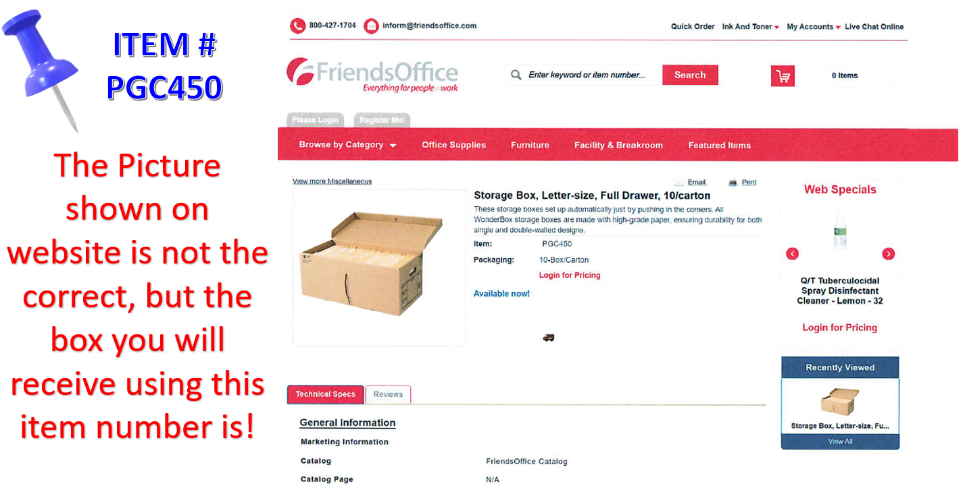
Processing Inactive Student Records for Digitization: Required Boxes
.

Slide 6
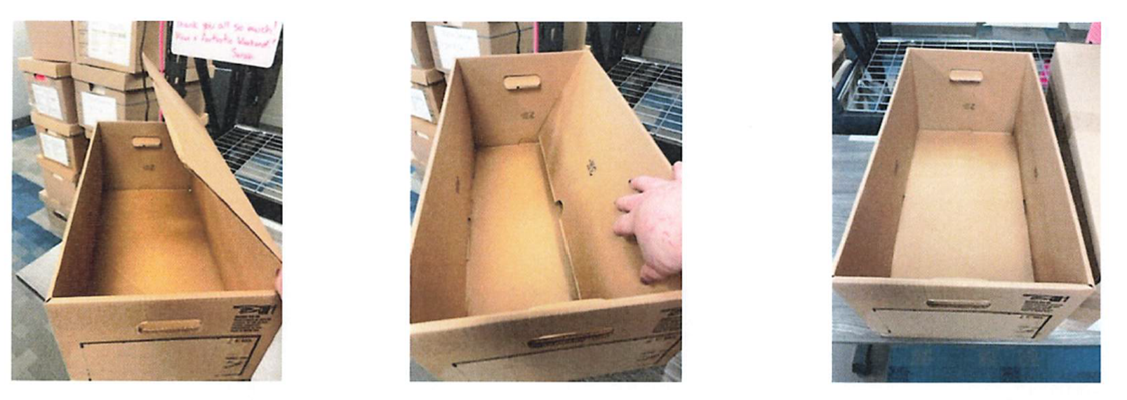
Processing Inactive Student Records for Digitization: Box Assembly
When assembling the required boxes, all flaps belong inside the box. Their purpose is to stabilize all sides to keep the box from being crushed under the weight of the other boxes stacked on top of them. Laying the flaps on top of the records prior to putting on the lid defeats the entire purpose; and as a result, Digitization becomes responsible for re-boxing all records inside the damaged boxes. Below you will see 3 images to give you a better understanding.

Slide 7
Processing Inactive Student Records for Digitization: Spreadsheet Data
The Digitization Spreadsheet, in your school’s O: Drive Folder, must be used to prepare records for Digitization.
At the top of this spreadsheet, it asks for identifying information. Please fill in all information, except for the Carton. This space may be used to notate Box 1, Box 2, etc. This is only for the benefit of School Records Personnel. This does not have to be done. (Carton # refers to the assigned number from boxes originally sent to the warehouse for retention, as explained on slide 12). DO NOT set up a Record Retention for your inactive student records.
DO NOT create a carton number from the Record Retention Database for records being sent to Digitization.
Spreadsheets may not be handwritten.
The student names on the spreadsheet MUST be in the same correct order as the records that are in the box.
It is imperative that the information on the spreadsheet be as accurate as humanly possible. It does not hurt to double check the information being entered.
*There is a highlighted yellow line on the spreadsheet that is a reminder to email the completed spreadsheet to the Division of the Registrar. This line may be deleted so that additional lines may be added, if contents in box are more than original lines provided.

Slide 8
Processing Inactive Student Records for Digitization: Spreadsheet Data
FYI:
The only spreadsheet that needs to be completed, for the purposes of Digitization of Inactive Student Records, is the Digitization Spreadsheet that is saved in each School O: Drive Digitization Folder.
You do NOT have to complete the Shredded Document Spreadsheet, nor the SPED Spreadsheet. Everything, with the exception of the Writing Portfolios and the Student Medical Folders, can remain inside the student cum folder and all contents will be digitized. (If in doubt, please reach out for clarification)

Slide 9
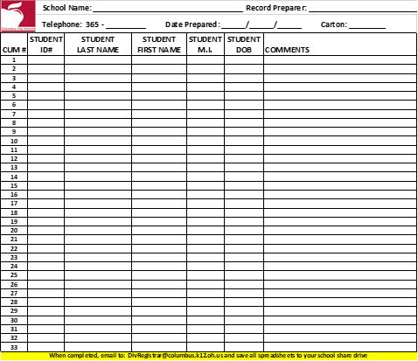
Processing Inactive Student Records for Digitization: Spreadsheet Data
Digitization Spreadsheet
The spreadsheet template, that must be used, is shown here. Each box of records requires its own digitization spreadsheet, listing only the contents within that box.
This is the “Yellow Line” mentioned on a previous slide, reminding the record preparer to email the completed spreadsheet to the Division of the Registrar.
It may be deleted, or the preparer may right click and add rows above it to fit each inactive student file onto one spreadsheet. Each box must contain its own individual spreadsheet that lists all records contained within.
This section is school information.
This section is the inactive student information contained within the box. Please provide as much detail as available

Slide 10
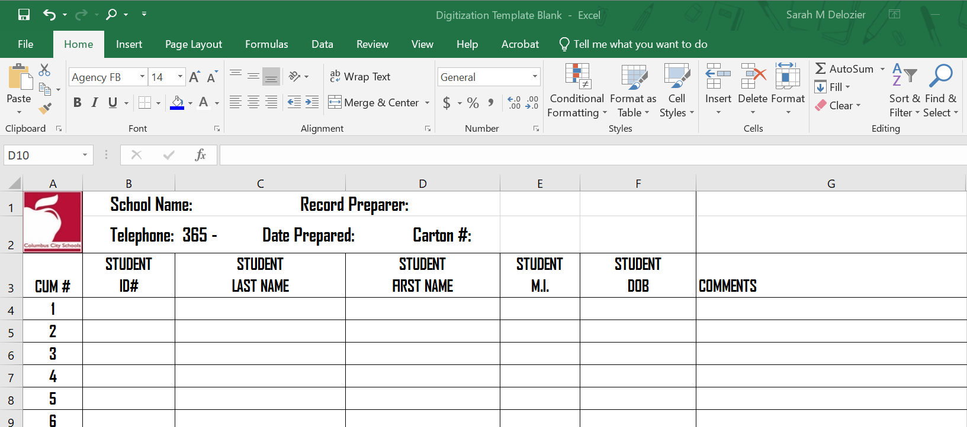
Processing Inactive Student Records for Digitization: Spreadsheet Data
Arrow A: Click in Column B at the start of text (the word “School”, and for the next row you will click the word “Telephone”) When you click the start of the word in column B, the rows information will appear in the formula bar, Arrow B. This is where you will type the necessary school and preparer information.
You will see more details on the next slide.
B
A

Slide 11
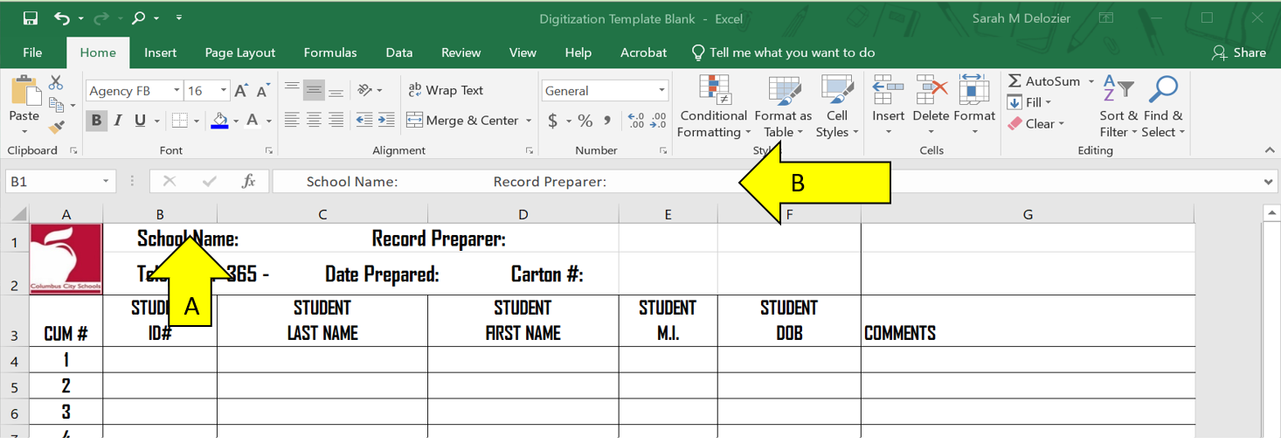
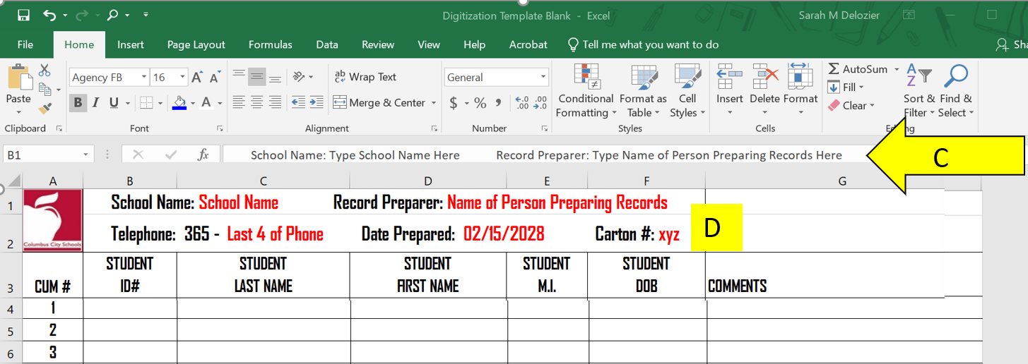
Processing Inactive Student Records for Digitization: Spreadsheet Data
A: Click in Column B at the start of the information Requested, (School and then Telephone)
B: That row of information will appear in the Formula Bar and this is where you will enter your information.
*The name of the person that processed the records must be listed on the spreadsheet.
C: Shows the information that you have typed into the formula bar.
D: Shows that same information as it will appear on the actual spreadsheet.

Slide 12
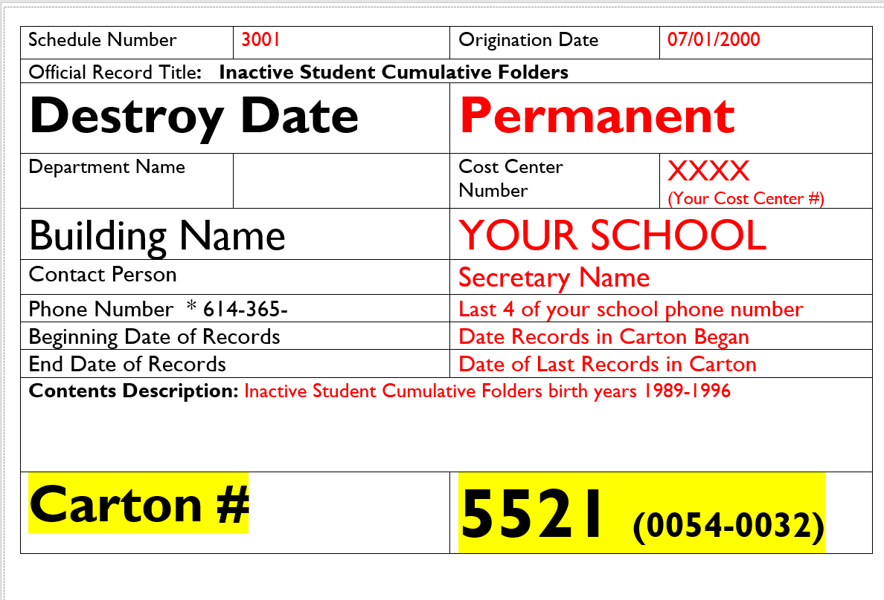
Processing Inactive Student Records for Digitization: Carton Number Explained
The Carton Number space on the spreadsheet pertains to a carton number that a box of records was assigned if it was ever retained at the warehouse for storage. We maintain the carton number so that we know if the carton has been processed for Digitization, it can officially be deleted off of the inventory list of records being held at the warehouse. The Carton Number is ONLY assigned if a Record Retention was created. Now that we do not have to hold records until the student reaches the age of 23, under no circumstance should a Record Retention be created for Inactive Student Records that need to be digitized. If you have created a Record Retention, you should have kept a record of the carton numbers, and what those boxes contained. Below is an example Record Retention Label and where that Carton Number would be found.
The retention label will not be in color, but I noted the key areas, and highlighted the carton number in YELLOW, so you would know where to look for the information.
The “5521” would be the Carton # on the Digitization Template.
So, the box of records that you are sending was never retained at the warehouse, you can leave that space blank, or you can use it for your own reference, such as “Carton 1 of 12”

Slide 13
Processing Inactive Student Records for Digitization
If the student has graduated, or becomes inactive with the Columbus City Schools District, the cumulative record will remain with the last school of attendance. While it is no longer required to maintain records until the student is 22 years of age, it is required that those records be maintained for one school year after the student graduates, or becomes an inactive student, before the records can be sent for digitization. For Example: Students that became inactive during, or at the end of, the 2021-2022 School Year cannot be sent for digitization until the beginning of the 2023-2024 School Year.
Oldest records must be prepared and sent for digitization first. Do not send recently graduated/inactive records if there are prior years that need to be processed.
The only items that need to be removed from the Student CUM Folder are:
The Student Writing Portfolio ~ To Be Shred According to Policy.
(These folders are a few different colors. A few examples are on the next slide)
2. Purple/Lavender Medical Folder ~ To be given to School Nurse
ALL OTHER RECORDS WILL BE DIGITIZED

Slide 14
Processing Inactive Student Records for Digitization
Writing Portfolios can be multiple different colors. Here are a few:

Slide 15
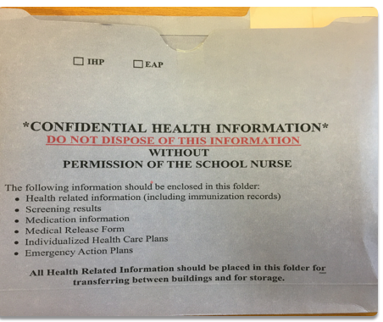
Processing Inactive Student Records for Digitization
The Student Health Information Folder, or Medical Folder, is to be removed from the Student’s CUM Folder and given to the School Nurse . These Student Health Folders are NOT to be destroyed!!!
Purple/Lavender Medical Folder

Slide 16
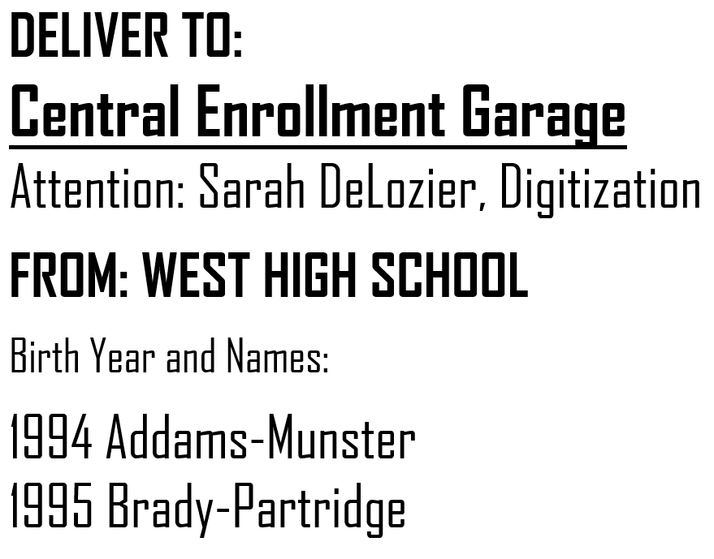
Processing Inactive Student Records for Digitization: Box Label
If records are being sent for digitization, labeling what is in each box plays a vital role in being able to locate a student’s cum that was mistakenly sent and needs to be returned or forwarded to a different CCS School. Having a label that is as detailed as possible will save an exhausting amount of time not having to dig through all boxes being held in the garage at Central Enrollment. Below is an example of such label:
.
This is just an example. As long as it identifies the school from which it came, and as much detail as possible to identify the boxes contents, any format chosen is fine. It is recommended the content detail on the box be the same name as the file that contains its specific spreadsheet as seen on this example. It simply makes it easier to identify every box without having to open each individual one.

Slide 17
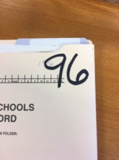
.
Processing Inactive Student Records for Digitization
Step 1
If not already done, please write the student’s birth year in the upper right corner of the cum folder, in bold permanent marker (i.e. birth year of 1996 would be written as 96)
Step 2
Separate the student cum folders by birth year and put them in alphabetical order. The records then need placed in a Long, Letter Sized Banker’s Box.
Again, the required boxes can be ordered from Friends, item # PGC450. The box dimensions are 25 ¼ x 13 x 10 ¼
(When you enter the PGC450 into Friends Office Supplies, a picture will show a box without removable lid. The picture is incorrect, but that is the correct order number for the accepted boxes.
IMPORTANT REMINDER: If Delivery Services does accept different boxes, records sent in anything other than the aforementioned box, #PGC450, will be returned for correction.

Slide 18
.
Processing Inactive Student Records for Digitization
Step 3
Once All of the students are in alphabetical order, by birth year, create the spreadsheet using the template provided to you. The required template can be found in the schools shared folder under Digitization, or on the Infinite Campus Dashboard under
Records>Digitization
*If accessing from Infinite Campus Dashboard be sure to download a copy, and not print from the preview page, to ensure you have the accurate layout of the document.
Step 4
At the top of the spreadsheet, enter the following information: School Name, Person Preparing Records, Telephone Number, and Date the records were processed.
Record Preparer may use the Carton section to notate the number of boxes (i.e. Box 1) but this is not required.
The Carton Portion of the Spreadsheet is for Digitization use.
*Do Not Create a Carton Number by Creating a Record Retention

Slide 19
.
Processing Inactive Student Records for Digitization
Step 5
Document the Student information on the required spreadsheet.
*Each box of records must have its own spreadsheet. The information on the spreadsheet should only contain the contents of the specific box. The order of the records on the spreadsheet should correlate with the order of the folders in that box. Example, the 7th student listed on the spreadsheet must be the 7th folder in the box.
FYI
Multiple birth years may be placed in one box and be on one spreadsheet, as long as they are in the correct ascending order with oldest records first. Example 1991, 1992, 1993, etc.
Spreadsheet must be saved in its original Excel format. Do Not save as a PDF. Only Excel documents should be saved in your schools digitization folder found in the O:Drive.
Do Not lock or protect the spreadsheet. The Division of the Registrar must be able to access and edit these documents to complete their responsibilities of this process

Slide 20
.
Processing Inactive Student Records for Digitization
Step 6
Once the spreadsheet is complete, and all student folders within that box are documented, save a copy of the spreadsheet in the school’s digitization folder in the O:Drive. The name must be saved in the following format:
West HS 1991 M-R, 1992 A-Y DIGITIZE
Or
West HS 1991 Martinez-Rodriguez, 1992 Addams-Young DIG
School Name, First Birth Year, First last name in that birth year, last name in that birth year, DIG or DIGITIZE
*You must show what last names are in each birth year.
FYI
Do Not use “A-Z” unless the last names in that birth year start with A and end with Z. The purpose of this is to be as descriptive as possible, so that it gives insight into what is on that spreadsheet prior to opening that file. While trying to locate a specific student, looking at the names of the saved files should give a clear indication of what boxes the student may potentially be in, or which ones can be ruled out. This will eliminate the time consuming search through every folder with that student’s birth year.

Slide 21
.
Processing Inactive Student Records for Digitization
Step 7
Once your spreadsheet has been saved with its proper name, print out a copy and place it inside the box, in front of the first folder. You must email a copy of that spreadsheet, in excel format, to:
DivRegistrar@columbus.k12.oh.us
With the subject line of:
“Digitization”, for authorization to schedule a
transfer of records.
Do Not Send Records Without Authorization from the Division of the Registrar.
Step 8
Once you receive authorization from the Division of the Registrar, you may schedule your TRANSFER of records to be sent to:
Central Enrollment Center
Garage
430 Cleveland Ave
Columbus, Ohio 43215
For guidance on setting up a transfer of records, please go to the link found on the Infinite Campus Dashboard, under Records>Digitization.

Slide 22
.
Processing Inactive Student Records for Digitization
If guidance is needed on how to save your completed spreadsheet to your school’s digitization folder on the O: Drive, please refer to the tutorial in the Student Records Handbook. The How to Save a Spreadsheet into the O: Drive PowerPoint provides detailed, screen by screen, guidance on how to locate your school’s digitization folder and how to ensure that your spreadsheet is saved in the correct place and will be easily located by the Digitization secretary.

Slide 23
In Conclusion:
After the boxes are received at Central Enrollment, the records will be verified, any errors will be recorded, and all items received will be documented. The Division of Registrar office is not responsible for any records that were added to a schools spreadsheet, but did not arrive to the Central Enrollment Center. In such an event, the school will be contacted and made aware of the missing cum folder. That box of records will be returned to the school, for the Records Personnel to add the items that were missing.
Any Legal questions should be directed to Legal Services at 614-365-5673.
Any Questions that you may have in regard to processing inactive student records, scheduling transfers, or the digitization process, please contact Sarah DeLozier
sdelozier@columbus.k12.oh.us office: 380-997-7335 Personal Cellphone: 614-266-2362
Please review the “How to Schedule a Transfer of Records Request” slides, if guidance is needed.

Slide 24
Acknowledgements
Thank you for your continued efforts learning this new process. Your hard work has not gone unnoticed.
Thank you for your patience and understanding as we work through this together.
If anything is ever needed, please do not hesitate to reach out. We are here to help whenever needed.

