Slide 1
Processing Inactive Student Records for Digitization
Responsibilities of the school secretaries and/or records personnel within the schools
Created By: Sarah Delozier

Slide 2
Processing Inactive Records for Digitization: Getting Started
What to Expect: The requirements for processing inactive student records for digitization have evolved as the needs have changed. To ensure the digitization process is simple and stress free, the Division of Registrar has created a guide to assist you through the updated procedures.
If at any point you have questions or concerns, please do not hesitate to reach out. We are more than happy to assist in any way that we can. Email: DivRegistrar@columbus.k12.oh.us My direct contact information is email: sdelozier@columbus.k12.oh.us Office: 380-997-7335 or you can call/text my personal cellphone: 614-266-2362.
No question is too big or too small. Please ask for assistance if it is needed. We are here to help, and understand that this is a learning process for everyone involved.

Slide 3
Processing Inactive Student Records for Digitization
If the student has graduated, or becomes inactive with the Columbus City Schools District, the cumulative record will remain with the last school of attendance. While it is no longer required to maintain records until the student is 22 years of age, it is required that those records be maintained for one school year after the student graduates, or becomes an inactive student, before the records can be sent for digitization.
Oldest records must be prepared and sent for digitization first. Do not send recently graduated/inactive records if there are prior years that need to be processed.
The only items that need to be removed from the Student CUM Folder are:
The Student Writing Portfolio ~ To Be Shred According to Policy.
(These folders are a few different colors. A few examples are on the next slide)
2. Purple Medical Folder ~ Give to School Nurse
ALL OTHER RECORDS WILL BE DIGITIZED

Slide 4
Processing Inactive Student Records for Digitization

Slide 5
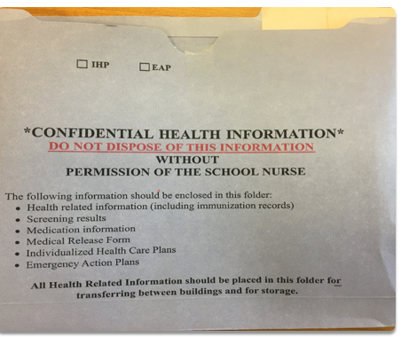
Processing Inactive Student Records for Digitization
The Student Health Information Folder, or Medical Folder, is to be removed from the Student’s CUM Folder and provided to the School Nurse . The Student Health Folders are not to be destroyed.
Purple Medical Folder

Slide 6
Processing Inactive Student Records for Digitization
Digitization Spreadsheet
The digitization spreadsheet must be used to prepare records for Digitization.
At the top of this spreadsheet, it asks for identifying information. Please fill in all information, except for the Carton. This space may be used to notate Box 1, Box 2, etc. This is only for the benefit of School Records Personnel. This does not have to be done.
Do not create a carton number from the Record Retention Database.
Spreadsheets may not be handwritten.
The student names on the spreadsheet MUST be in the same order as the records are in the box.
*There is a highlighted yellow line on the sheet that is a reminder to email the completed spreadsheet to the Division of the Registrar. This line may be deleted so that lines may be added, if contents in box are more than original lines given.

Slide 7
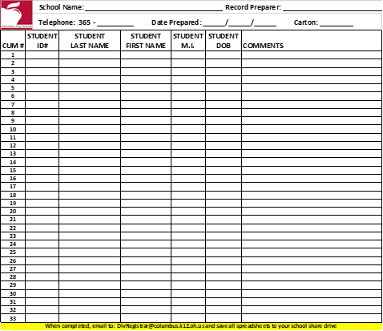
Processing Inactive Student Records for Digitization
Digitization Spreadsheet
The spreadsheet template, that must be used, is shown here. Each box of records requires its own digitization spreadsheet, listing only the contents within that box.
This is the “Yellow Line” mentioned on previous slide, reminding the record preparer to email the completed spreadsheet to the Division of the Registrar.
It may be deleted, or the preparer may right click and add rows above it to fit each inactive student file onto one spreadsheet. Each box must contain one spreadsheet that lists all records contained within.
This section is school information.
This section is the inactive student information contained within the box. Please provide as much detail as available

Slide 8
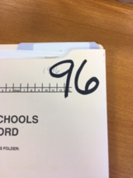
.
Processing Inactive Student Records for Digitization
Step 1
If not already done, please write the student’s birth year in the upper right corner of the cum folder, in bold permanent marker (i.e. birth year of 1996 would be written as 96)
Step 2
Separate the student cum folder by birth year and put them in alphabetical order. Records then need placed in to a Banker’s Box.
*Bankers Boxes are required for records to be accepted. They can be ordered from Friends, item # FEL0065901. The box dimensions are 25 ¼ x 13 x 10 ¼
(If you have boxes that are another brand of comparable size, with removable lids, those will be acceptable.)
Records sent in any other box will be returned for correction.

Slide 9
.
Processing Inactive Student Records for Digitization
Step 3
Once All of the students are in alphabetical order, by birth year, create the spreadsheet using the template provided to you. The required template can be found in the schools shared folder under Digitization, or on the Infinite Campus Dashboard under
Records>Digitization
*If accessing from Infinite Campus Dashboard be sure to download a copy, and not print from the preview page, to ensure you have the accurate layout of the document.
Step 4
At the top of the spreadsheet, enter the following information: School Name, Person Preparing Records, Telephone Number, and Date the records were processed.
Record Preparer may use the Carton section to notate the number of boxes (i.e. Box 1) but this is not required.
The Carton Portion of the Spreadsheet is for Digitization use.
*Do Not Create a Carton Number by Creating a Record Retention

Slide 10
.
Processing Inactive Student Records for Digitization
Step 5
Document the Student information on the required spreadsheet.
*Each box of records must have its own spreadsheet. The information on the spreadsheet should only contain the contents of the specific box. The order of the records on the spreadsheet should correlate with the order of the folders in that box. Example, the 7th student listed on the spreadsheet must be the 7th folder in the box.
FYI
Multiple birth years may be placed in one box and be on one spreadsheet, as long as they are in the correct ascending order with oldest records first. Example 1991, 1992, 1993, etc.
Spreadsheet must be saved in its original Excel format. Do Not save as a PDF. Only Excel documents should be saved in your schools digitization folder found in the O:Drive.
Do Not lock or protect the spreadsheet. Division of the Registrar must be able to access and edit these documents to complete their responsibilities of this process

Slide 11
.
Processing Inactive Student Records for Digitization
Step 6
Once the spreadsheet is complete, and all student folders within that box are documented, save a copy of the spreadsheet in the school’s digitization folder in the O:Drive. The name that it needs to be saved in, needs to be in the following format:
West Valley HS 1991 M-R, 1992 A-Y DIGITIZE
Or
West Valley HS 1991 Martinez-Rodriguez, 1992 Addams-Young DIG
School Name, First Birth Year, First last name in that birth year, last last name in that birth year, DIG or DIGITIZE
*You must show what last names are in each birth year.
FYI
Do Not use “A-Z” unless the last names in that birth year start with A and end with Z. The purpose of this is to be as descriptive as possible, so that it gives insight into what is on that spreadsheet prior to opening that file. While trying to locate a specific student, looking at the names of the saved files should give a clear indication of what boxes the student may potentially be in, or which ones can be ruled out. This will eliminate the time consuming search through every folder with that student’s birth year.

Slide 12
.
Processing Inactive Student Records for Digitization
Step 7
Once your spreadsheet has been saved with its proper name, print out a copy and place it inside the box, in front of the first folder. You must email a copy of that spreadsheet, in excel format, to:
DivRegistrar@columbus.k12.oh.us
With the subject line of:
“Digitization”, for authorization to schedule a
transfer of records.
Do Not Send Records Without Authorization from the Division of the Registrar.
Step 8
Once you receive authorization from the Division of the Registrar, you may schedule your TRANSFER of records to be sent to:
Central Enrollment Center
Records Room 206
430 Cleveland Ave
Columbus, Ohio 43215
For guidance on setting up a transfer of records, please go to the link found on the Infinite Campus Dashboard, under Records>Digitization.

Slide 13
In Conclusion:
After the boxes are received at CE, the records will be verified, any errors will be corrected, and all items received will be documented. The Division of Registrar office is not responsible for any records that were added to a schools spreadsheet, but did not arrive to the Central Enrollment Center. In such an event, the school will be contacted and made aware of the missing cum folder. That box of records will be returned to the school, for the Records Personnel to add the items that were missing.
Any Legal questions should be directed to Legal Services at 614-365-5673.
Any Questions that you may have in regard to processing inactive student records, scheduling record transfers, or the digitization process, please contact Sarah DeLozier
sdelozier@columbus.k12.oh.us office: 380-997-7335 Personal Cellphone: 614-266-2362
Please review the “How to Schedule a Transfer of Records Request” slides, if guidance is needed.

Slide 14
Acknowledgements
Thank you for your continued efforts learning this new process. Your hard work has not gone unnoticed.
Thank you for your patience and understanding as we work through this together.
If anything is ever needed, please do not hesitate to reach out. We are here to help whenever needed.

