Slide 1
Guidance for Creating a
Reading Improvement and Monitoring Plan
Notes:
Today, we’ll discuss Ohio’s Third Grade Reading Guarantee requirements and expectations for creating a Reading Improvement and Monitoring Plan.

Slide 2
3GRG State Requirements
In the Fall, all students Kindergarten- 3rd grade, are required to take a reading diagnostic assessment to determine if they are on track or not on track to read on grade level by the end of 3rd grade.
Kindergarten students are given the KRA and use the Language and Literacy Domain to determine if they are on track. This assessment should be completed and data entered into the KReady system by September 28th. The remaining components must be entered no later than November 1st.
Notes:
The State of Ohio Third Grade Reading Guarantee legislation requires that all students in Kindergarten through 3rd grade complete a reading diagnostic assessment to determine if they are on track or not on track to read on grade level by the end of 3rd grade. Kindergarten students will complete the Language and Literacy domains of the KRA, or Kindergarten Readiness Assessment to complete this requirement. Language and Literacy data must be entered into the KReady system by September 28th, and the remaining components of the KRA must be entered no later than November 1st.

Slide 3
3GRG State Requirements
New K students received after Sept. 28th, are required to have all components of the KRA completed, including Language and Literacy, by Nov. 1st.
New students received after Nov. 1st, will use the MAP (Growth: Reading K-2) as their ODE Reading Diagnostic Assessment. This must be administered within 30 days of their enrollment.
Notes:
Kindergarten students that enroll after September 30 are required to have all components of the KRA completed by Nov. 1st. New Kindergarten students enrolled after November 1st will complete the MAP Growth: Reading as their required ODE reading diagnostic assessment. Students must complete this assessment within 30 days of enrolling unless a state approved diagnostic was taken at a previous school.

Slide 4
3GRG State Requirements
Retained Kindergarten students and 1st-3rd grade students are given the MAP to determine if they are on track. This assessment should be completed by September 28th.
3rd Grade Mid Year RIMP Creation
Third grade students that did not meet the scaled score of 700 on the ELA Ohio’s State Test/ AIR are also required to have a RIMP.
Notes:
Students that are repeating Kindergarten, and students in first through third grade will complete the MAP assessment to determine their on track/not on track status. This assessment must be completed by September 28th. Additionally, third grade students that do not meet the scaled score of 700 on the fall administration of the Ohio State Test in English Language Arts, or AIR assessment, are also required to have a Reading Improvement and Monitoring Plan, or RIMP.

Slide 5
3GRG State Requirements
For each student who is not on track, schools must:
Administer any necessary informal or formal diagnostic assessment to determine the needs of the student
Immediately provide reading instruction and intervention using research based reading strategies that have been shown to be successful in improving reading among low-performing readers and are targeted at the student’s identified reading deficiency
Create a Reading Improvement and Monitoring Plan (RIMP), within 60 days of when the student was designated not on track.
Notes:
For those students determined to be not on track, schools must complete the following requirements: Administer any necessary informal or formal diagnostic assessments to determine the needs of the student. Immediately provide reading instruction and intervention using research-based reading strategies that have proven successful in improving reading among low-performing readers and are targeted at the student’s identified reading deficiencies. Create the RIMP within 60 days of when the student was designated not on track. Please note, this is not 60 days after September 28th, since most students are assessed prior to this date.

Slide 6
3GRG State Requirements
A plan must include:
Identification of the student’s specific reading deficiency
A description of proposed supplemental instruction services that will target the student’s identified reading deficiencies
Opportunities for the student’s parents or guardians to be involved in creating the plan and in the instructional supports provided
Notes:
The Reading Improvement and Monitoring Plan must include:
identification of the student’s specific reading deficiency
a description of proposed supplemental instruction services that will target the student’s identified reading deficiencies
opportunities for the student’s parents or guardians to be involved in the creation of the plan and in the instructional supports provided

Slide 7
3GRG State Requirements
A process to monitor the implementation of the student’s instructional services
A reading curriculum during regular school hours that assists students to read at grade level and provides for reliable tests and ongoing analysis of each student’s reading progress
A statement that, Unless the student attains the appropriate level of reading competency by the end of grade 3, the student will be retained, unless otherwise exempt.
Notes:
The RIMP must also include:
a process to monitor the implementation of the student’s instructional services
a reading curriculum during regular school hours that assists students to read at grade level and provides for reliable tests and ongoing analysis of each student’s reading progress
and a statement that Unless the student attains the appropriate level of reading competency by the end of grade 3, the student will be retained, unless otherwise exempt.

Slide 8
RIMPs on Infinite Campus
Some things to note about this process:
The form is already in Infinite Campus, it will not need to be uploaded.
Additional areas of information are now prepopulated, while some information has been eliminated.
The form has been updated to more closely align with District assessment and instruction calendars.
Notes:
During the 2017-2018 school year, a team of teachers, administrators, TOSA’s, and CEA met to update and modify the CCS RIMP document. Columbus City Schools Reading Improvement and Monitoring Plan is a fillable form located in Infinite Campus. Portions of the document will pre-populate information from Infinite Campus and the document has been updated to more closely align with District assessment, instruction, and conference schedules.

Slide 9
Student Information
The form is already connected to individual students, so some fields will be automatically populated.
These fields include: School Name, Current Date, Student ID, Student Name, Date of Birth, Student Grade Level, & Teacher.
Example:
Notes:
Infinite Campus will prepopulate the following fields: school name, current date, student ID number, student name, date of birth, grade level, and teacher of record.

Slide 10
Student Information
The following fields will not pre-populate and will need to be completed by the teacher before the document can be saved:
Notes:
These fields will not pre-populate, but must be completed before the document can be saved in Infinite Campus. A “yes” response to any of these signals that additional information regarding the student can be found in Infinite Campus or in the student’s cummulative records.

Slide 11
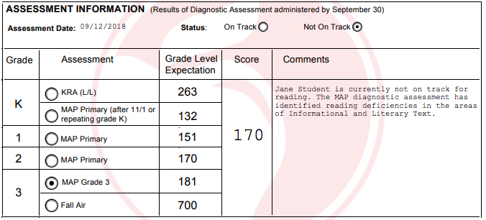
Student Information
Kindergarten - KRA Language and Literacy (until Nov. 1st)
NWEA MAP for Primary Grades after Nov. 1st.
Grades 1 and 2 – NWEA/ MAP for Primary Grades (reading) Cut score placed in Grade Expectation
Grade 3 – NWEA/ MAP (Cut score placed in Grade Expectation) and Ohio’s State Reading Test (AIR))
Notes:
The remainder of the document will need to be completed by the teacher. It is also important to note that parents should be a part of the creation of the RIMP

Slide 12
Student Information
NEW! - MAP scores will now prepopulate if the RIMP is created after scores have been uploaded to Infinite Campus!
Notes:
If the RIMP is created after MAP scored have been uploaded to Infinite Campus, the score and assessment date will pre-populate. Teachers creating a RIMP before the data is uploaded will need to enter this information.

Slide 13
Information for Families
These descriptions on the RIMP are provided to inform parents about this document and important details about 3GRG.
Information for families has been updated to Parent-Friendly language.
Notes:
Information that explains the RIMP to parents can be found throughout the RIMP. This information has been updated to more parent-friendly language and can be used to assist parents in understanding the needs of their child and the instructional supports being provided.

Slide 14
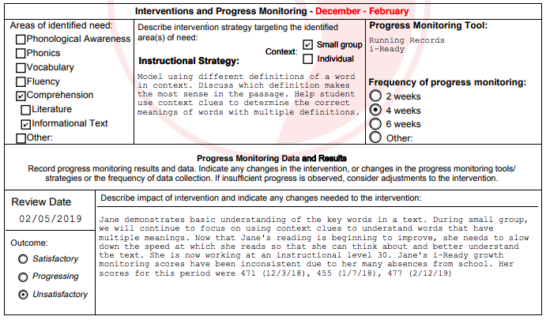
Intervention and Progress Monitoring
Progress will be documented according to the following schedule:
September - November, December - February, March - May.
Teachers should review the RIMP by making note of the outcome of the progress monitoring and describe the impact of the intervention.
Notes:
Throughout the year, teachers will review the RIMP and make note of the outcome of progress monitoring assessments, describe the impact of the intervention, and note any changes to instructional focus or strategies. Progress monitoring documentation has been aligned to the district Parent Teacher conference schedule and the end of the year.
Satisfactory- student is showing strength in this area
Progressing- student is making progress but still needs support in this area
Unsatisfactory- student is not making progress and still needs intensive support

Slide 15
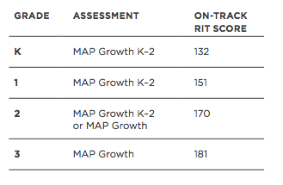
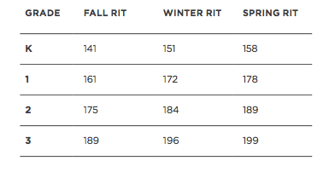
Intervention and Progress Monitoring
Fall “On Track” Cut Score:
Grade Level Expectation
Students should receive progress monitoring according to the following schedule:
Far Below: Every 2 weeks
Below: Every 4 weeks
On Level: Every 6 weeks
Notes:
Frequency of progress monitoring is determined by the needs of the student: students determined to be far below proficient needing intensive intervention will be progress monitored every 2 weeks, students below proficient needing strategic intervention will be progress monitored every 4 weeks, and students that are determined to be proficient will be progress monitored every 6 weeks.
Satisfactory- student is showing strength in this area
Progressing- student is making progress but still needs support in this area
Unsatisfactory- student is not making progress and still needs intensive support

Slide 16
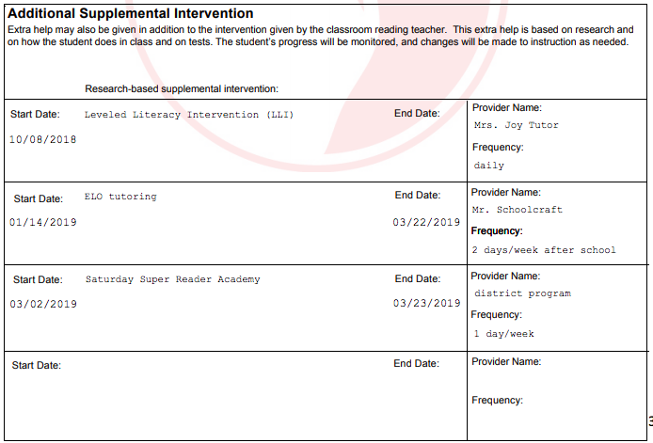
Additional Supplemental Interventions
Notes:
Supplemental instruction should be research based, should be in addition to the regular classroom instruction provided for all students, and should be in addition to the intervention provided by the teacher of record. These are the interventions that occur outside of the classroom. Special Education tutors working on an IEP and ESL tutors are not listed on this section of the RIMP.

Slide 17
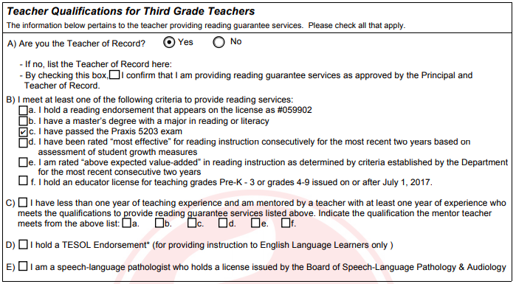
Teacher Qualifications
Only third grade teachers are required to complete this section.
Check all that apply
Notes:
Third grade teachers are required to complete this section of the RIMP. If the teacher of record does not qualify under the guidelines of the Third Grade Reading Guarantee, it must be noted and the teacher providing reading instruction must be noted.

Slide 18
Parental Involvement
Parental opportunities may include but are not limited to:
Notes:
Parents should choose the activities they plan to participate in to support their child.

Slide 19
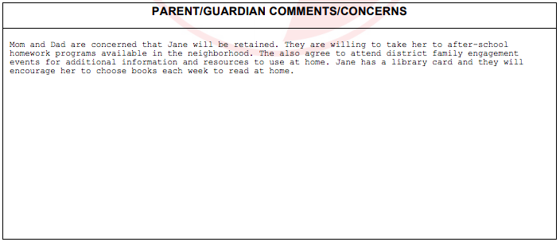
Parental Involvement
Teachers should write any comments or concerns from the parent or guardians regarding the plan that has been created.
Notes:
Parents should be notified that students that are not on track by third grade will be retained.

Slide 20
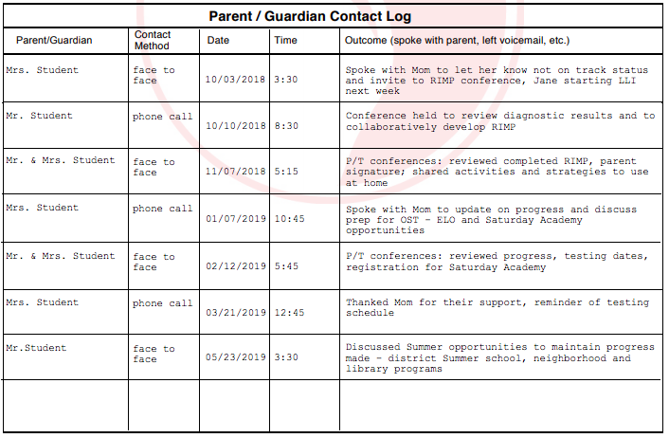
Parent Contact Log
It is important to note the Parent Contacts and results of those contacts.
Notes:
This information has moved back to the RIMP instead of being placed in the Contact Log section of Infinite Campus.

Slide 21
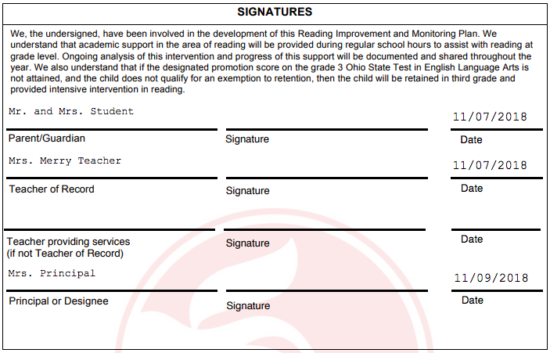
Parental Involvement
Teachers will need to print this last page to get parent’s signature. This page will be filed in the Compliance notebook within the office.
Notes:
The signature page will be printed for parent signature. The signature page will be stored in the compliance notebook in the school office.

Slide 22
RIMPs on Infinite Campus
Additional things to note about this process:
The form can be edited throughout the course of the plan, so the information is always up to date without the need to fill out and upload a new form.
Notes:
The RIMP can be edited and updated as needed so that information is up to date without the need to complete a new form or upload new pages.

Slide 23
Sample RIMPs
Take a look at the RIMP examples.
What do you notice?
What questions do you have based
on what you see?
Notes:
Take a look at the sample RIMPS:
What do you notice?
What questions do you have?

Slide 24
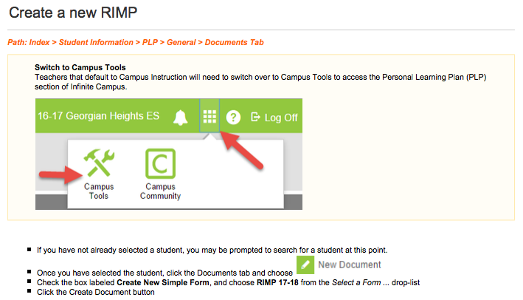
Infinite Campus Directions
Notes:
Directions for creating and editing a RIMP in Infinite Campus can be found in the digital resource binder.
Teachers will receive an informational sheet the provides details about how to Create, Edit, and make Comments on Infinite Campus.

Slide 25
State Requirements
Additional Resources:
Ohio Department of Education: Third Grade Reading Guarantee:
http://education.ohio.gov/Topics/Learning-in-Ohio/Literacy/Third-Grade-Reading-Guarantee
ODE Third Grade Reading Guarantee Guidance Manual
http://education.ohio.gov/getattachment/Topics/Early-Learning/Third-Grade-Reading-Guarantee/TGRG-Guidance-Manual.pdf.aspx
Notes:
Additional information and guidance for these state requirements can be found on the Ohio Department of Education website and in the Third Grade Reading Guarantee Guidance Manual.

Slide 26
Additional Resources
CCS Elementary Digital Resource Binder:
https://sites.google.com/columbus.k12.oh.us/elementaryteacherresources/reading
Notes:
Information and resources for completing the Columbus City Schools Reading Improvement and Monitoring Plan documents can be found in the Elementary Digital Resource Binder.

Slide 27
Questions
Notes:
All reading improvement and monitoring plans must be created within 60 days of when a student is designated not on-track. It shall include:
1). Identification of the student’s specific reading deficiency;
2). A description of proposed supplemental instruction services that will target the student’s identified reading deficiencies;
3). Opportunities for the student’s parents or guardians to be involved in the instructional services;
4). A process to the monitor the implementation of the student’s instructional services;
5). A reading curriculum during regular schools hours that assists students to read at grade level, provides for reliable assessments, and provides ongoing analysis of each student’s reading progress
Beginning in the 2013-2014 school year, districts must provide a qualified teacher to each student who enters third grade that is on a reading improvement and monitoring plan or has been retained.

